Slide 1

Mobile Application Development, Fall 2021 Navigation with Parameters

Slide 2
Today’s Agenda
Displaying Our Lists of Results!
Displaying a Detail Page!

Slide 3
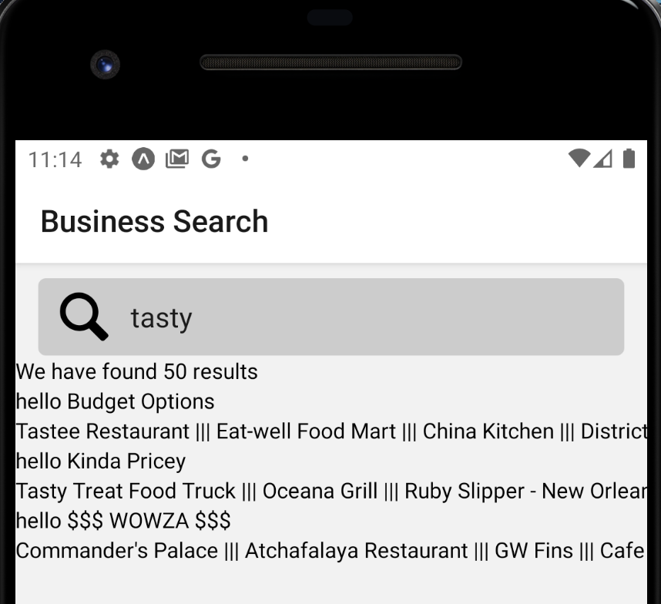
Displaying Our Lists of Results!
So, this is as far as we got last time!
We *do* in fact have a list of restaurants, but there is quite a lot of styling left to be applied.

Slide 4
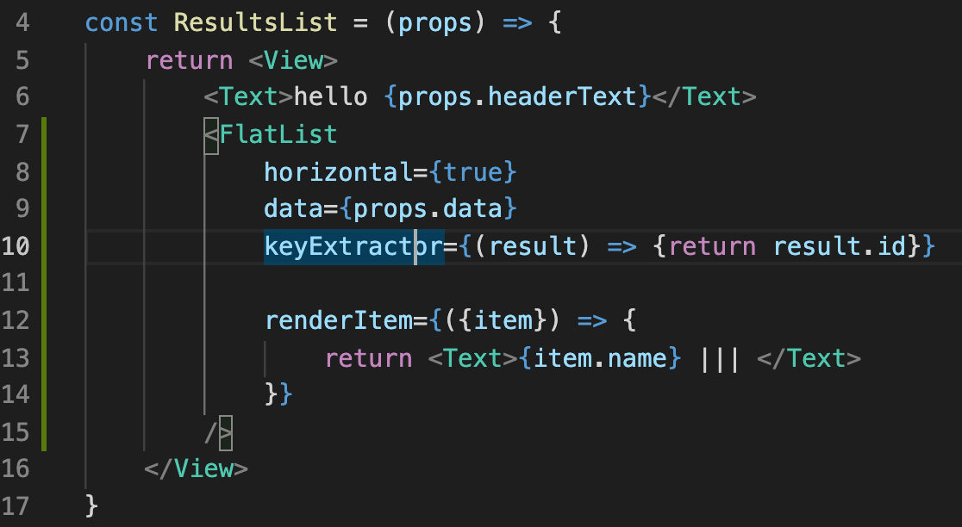
Displaying Our Lists of Results!
Currently it is in our FlatList’s renderItem prop that we define what it looks like.
Right now it is just a single Text element…
But we could flesh this out and return a ton of JSX with everything we want!

Slide 5
Displaying Our Lists of Results!
But that would make the ResultsList be so bulky…
And it would “trap” that JSX inside of it.
What if we ever wanted to display a single restaurant OUTSIDE of a list?

Slide 6
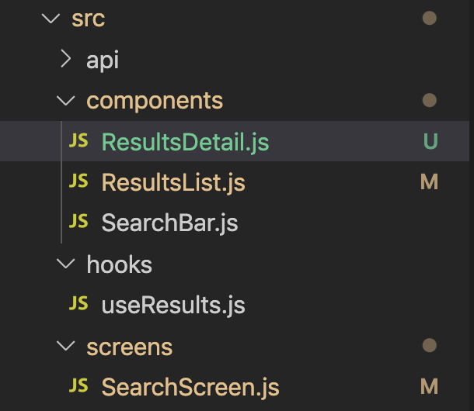
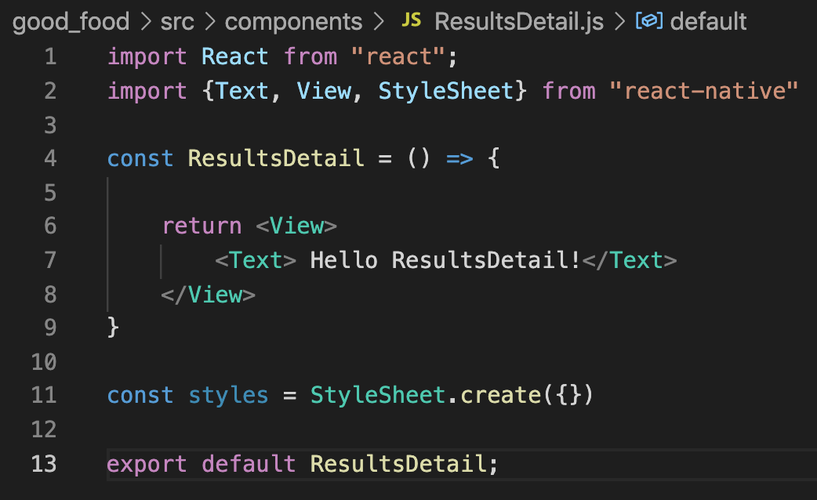
Displaying Our Lists of Results!
The solution is clear: let’s make a reusable component!
Let’s call it “ResultsDetail” – as it is basically a detailed representation of a single Result.
And we can give it some boilerplate code as well.

Slide 7
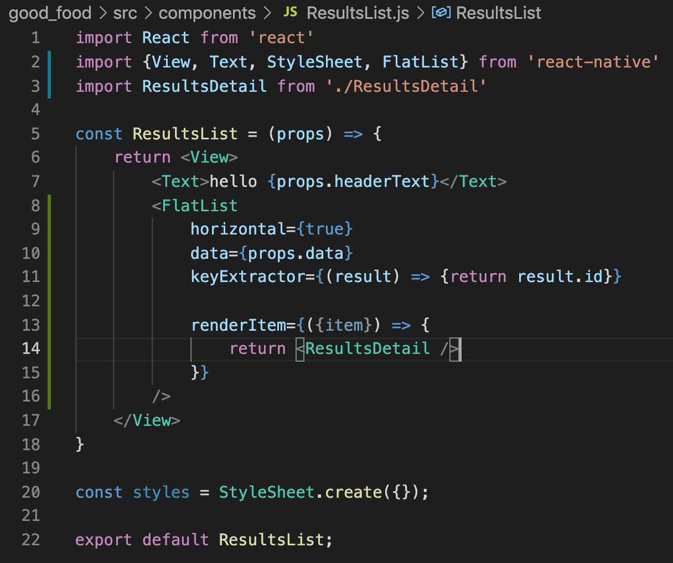
Displaying Our Lists of Results!
We can then start making use of that in our ResultsList component!
We import it…
And we return it in renderItem!
Clearly it is unfinished at this point though!

Slide 8
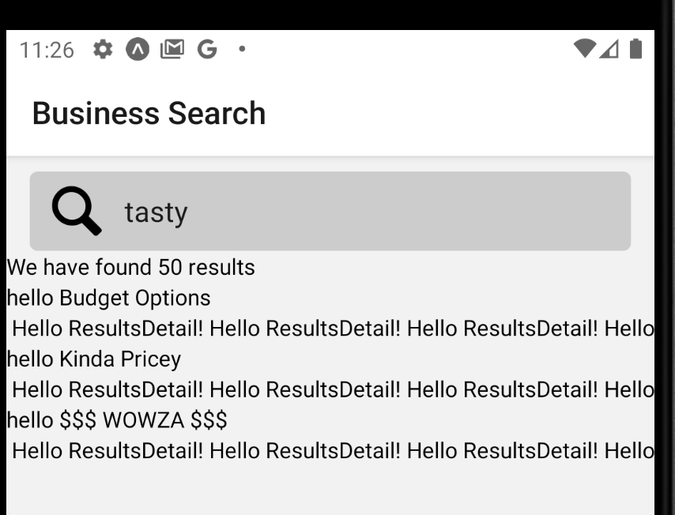
Displaying Our Lists of Results!
Yup. It now just prints our boilerplate for ResultsDetail a million times.
But that’s OK! We’ll just make ResultsDetail better looking!

Slide 9
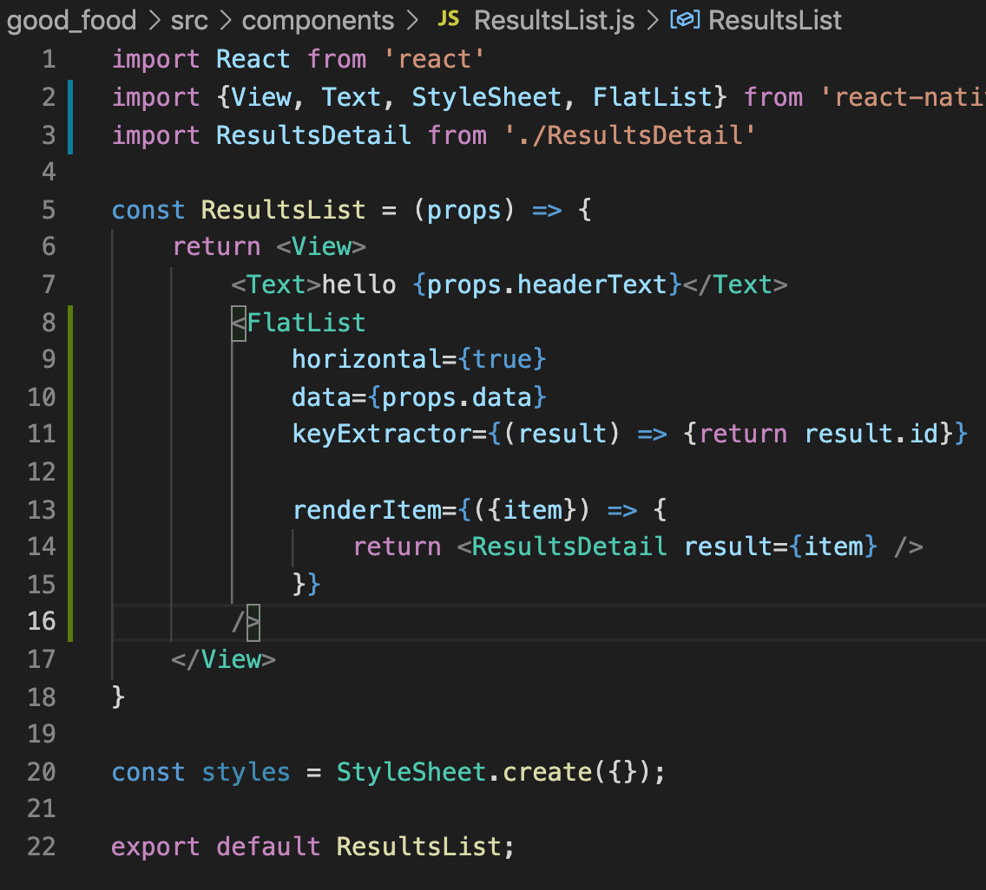
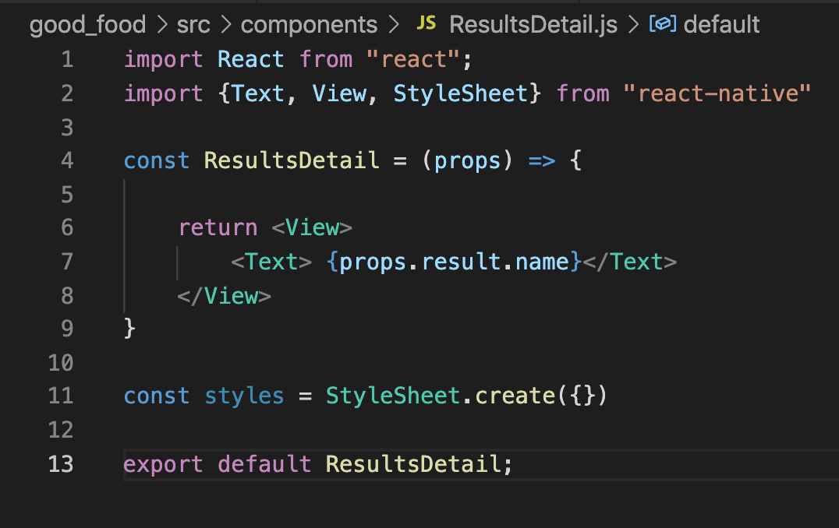
Displaying Our Lists of Results!
Let’s pass in a prop to ResultsDetail – specifically, the item that we are trying to render!
And then, in ResultsDetail, we receive the props…
And then make use of it – here, we simply print out the name property of the result that was passed in.

Slide 10
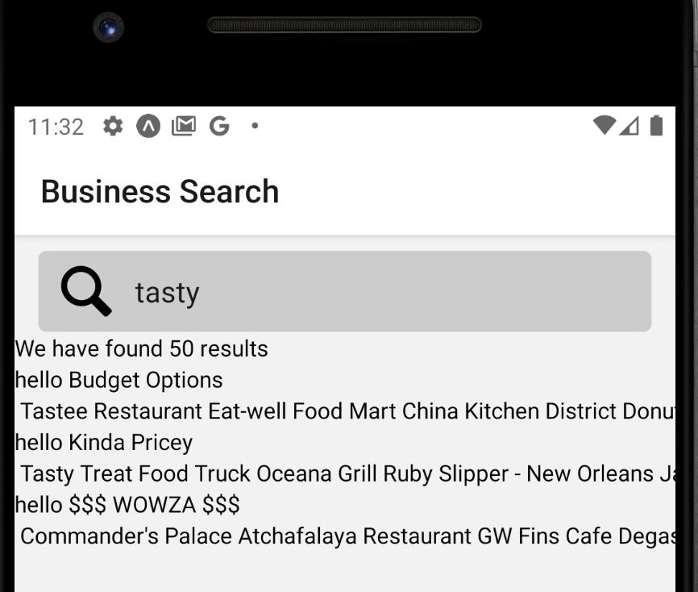
Displaying Our Lists of Results!
It basically gets us back to where we were a second ago…
BUT!
Now we have this nice reusable component set up!
Which we can really start to gussy up!

Slide 11
Displaying Our Lists of Results!
Let’s do it! Let’s finally style this so that our restaurants look nice!
Let’s start by adding an image.

Slide 12
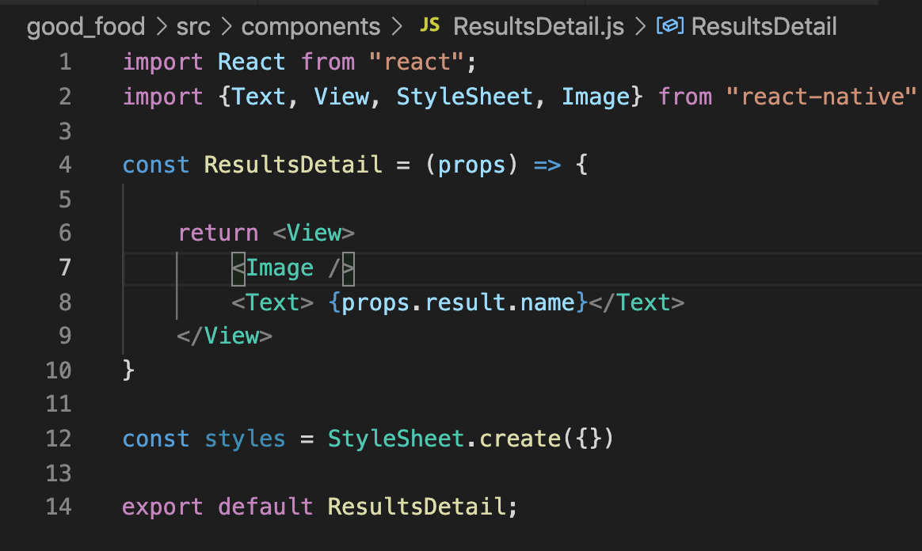
Displaying Our Lists of Results!
We can of course import Image…
And then start to make use of it…
However, we’re going to use this in a slightly different way than previous images.

Slide 13
Displaying Our Lists of Results!
Before – we had the image file on our local machines, and we specified it using a require statement.
Now – the Yelp API gives us the URL of an image location.
We’ll specify our image making use of that!

Slide 14
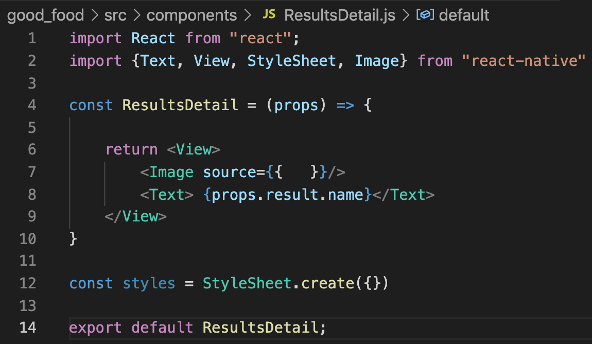
Displaying Our Lists of Results!
In order to do so, we’ll still specify the Image component’s source prop.
But we’ll pass in a new object to it.
Remember: the ‘outer’ { } on line 7 signifies “this is going to be JavaScript”
And the ’inner’ { } on line 7 means “I am creating a new JavaScript object.

Slide 15
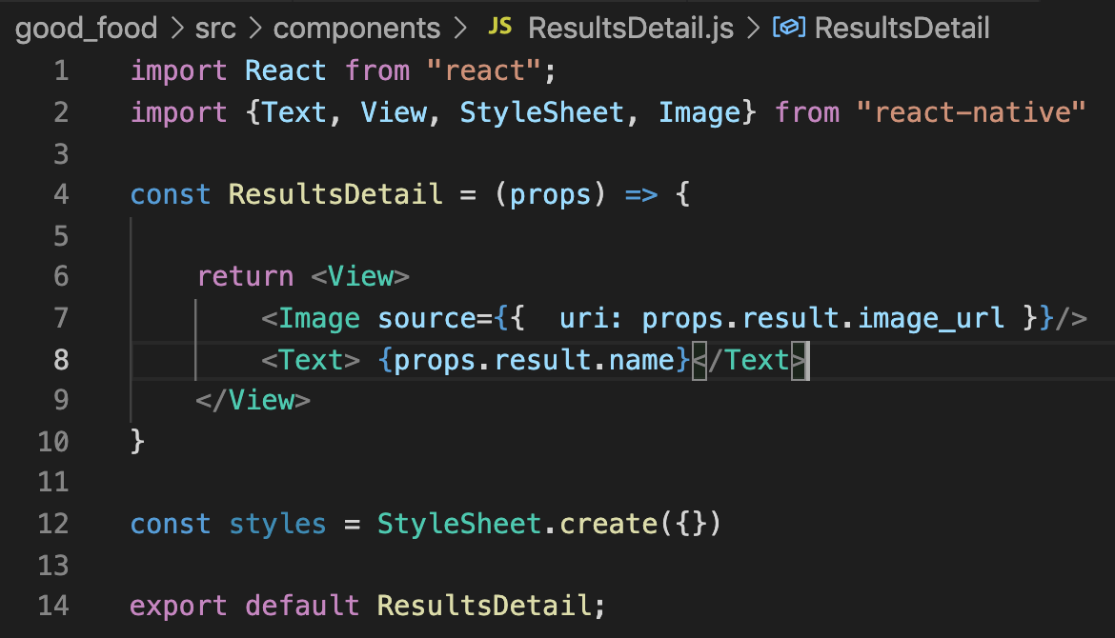
Displaying Our Lists of Results!
We’ll give that object a uri property
Uri stands for “Uniform Resource Identifier”
And have its value be the result’s “image_url”
Recall: that’s the property from the Yelp API that has the url of the image Yelp uses to display that restaurant.

Slide 16
Displaying Our Lists of Results!
Sadly, if we were to double check this, there would be no images.
Why is that?
It is because the Image tag collapses its content down to the minimum height it can get away with.
Here it is collapsing to nothingness.

Slide 17
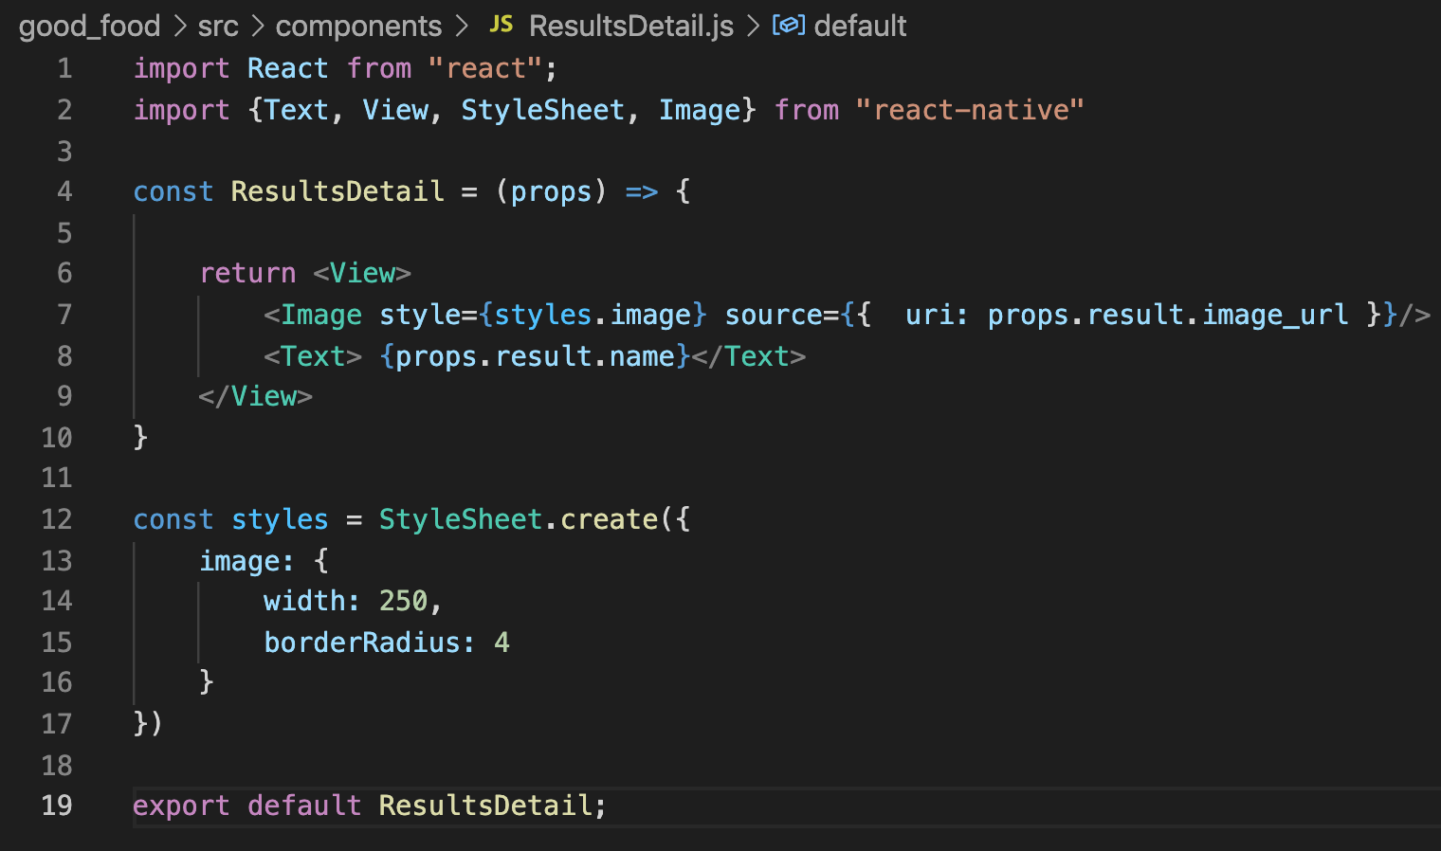
Displaying Our Lists of Results!
We can add in styling information to the Image…
Which feels like it should solve that collapsing problem…

Slide 18
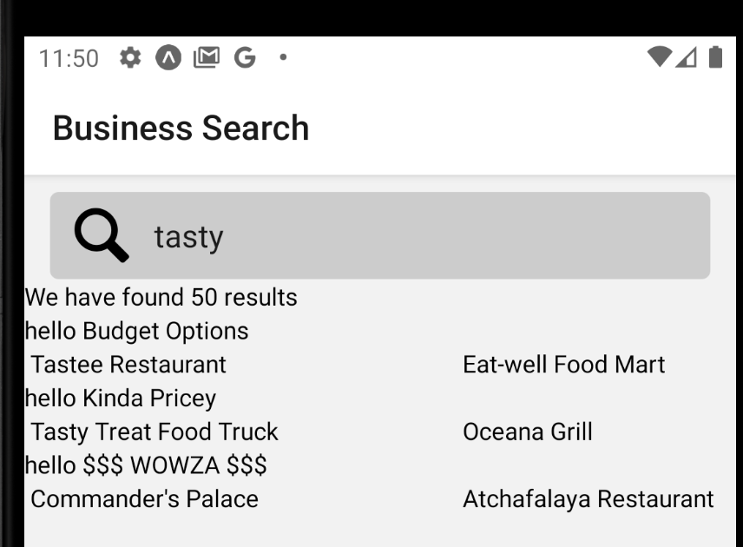
Displaying Our Lists of Results!
But all it does is add in weird space!
What gives?
Where is the picture?

Slide 19
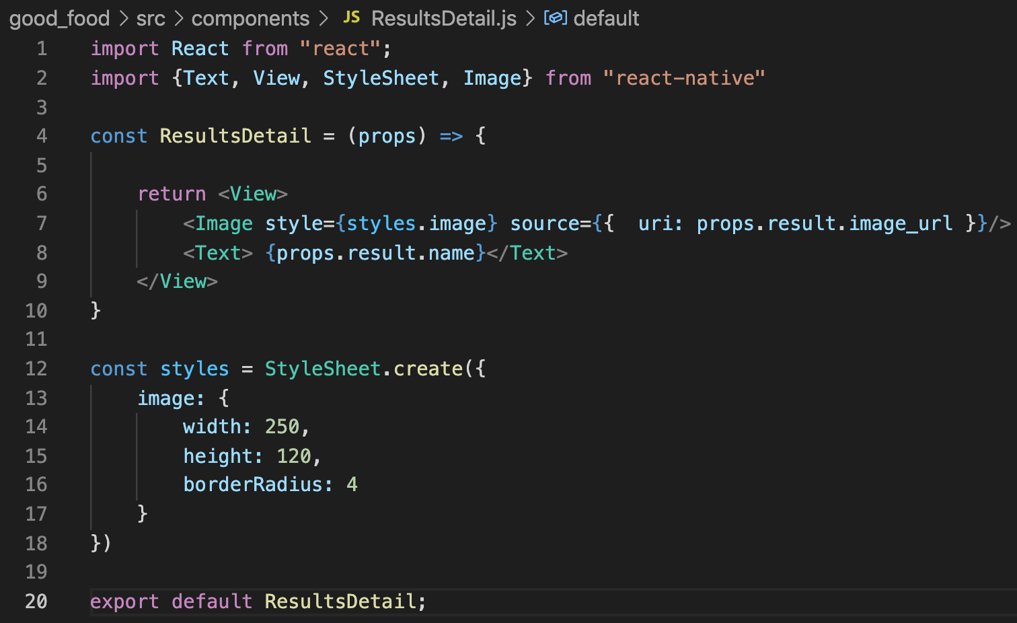
Displaying Our Lists of Results!
WELL – we needed to give it a height as well.
It was collapsing to 0 along the up-down dimension.
Here we are specifying a fixed height, but other options exist!

Slide 20
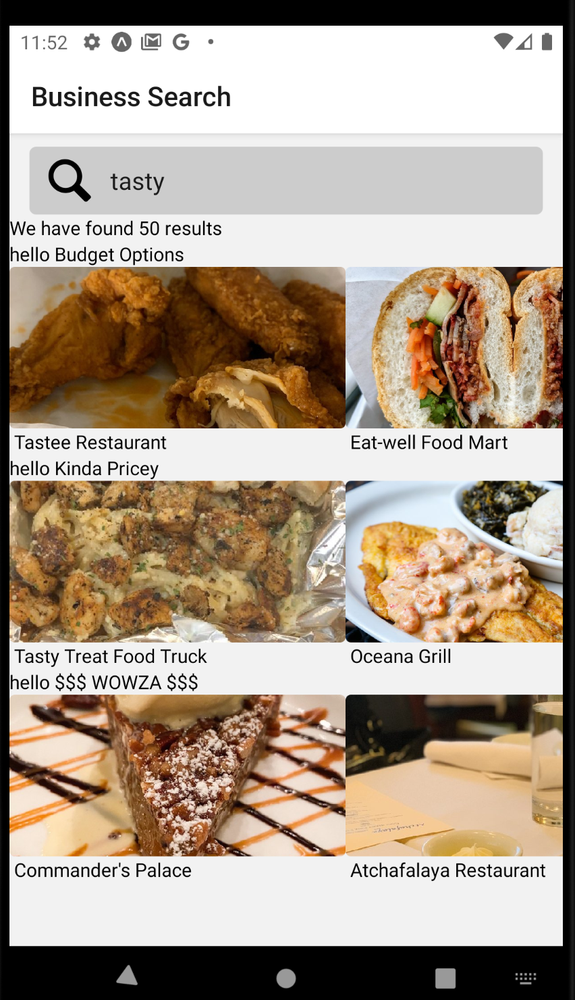
Displaying Our Lists of Results!
And now…
FINALLY…
We have some pretty pictures!
Wow!

Slide 21
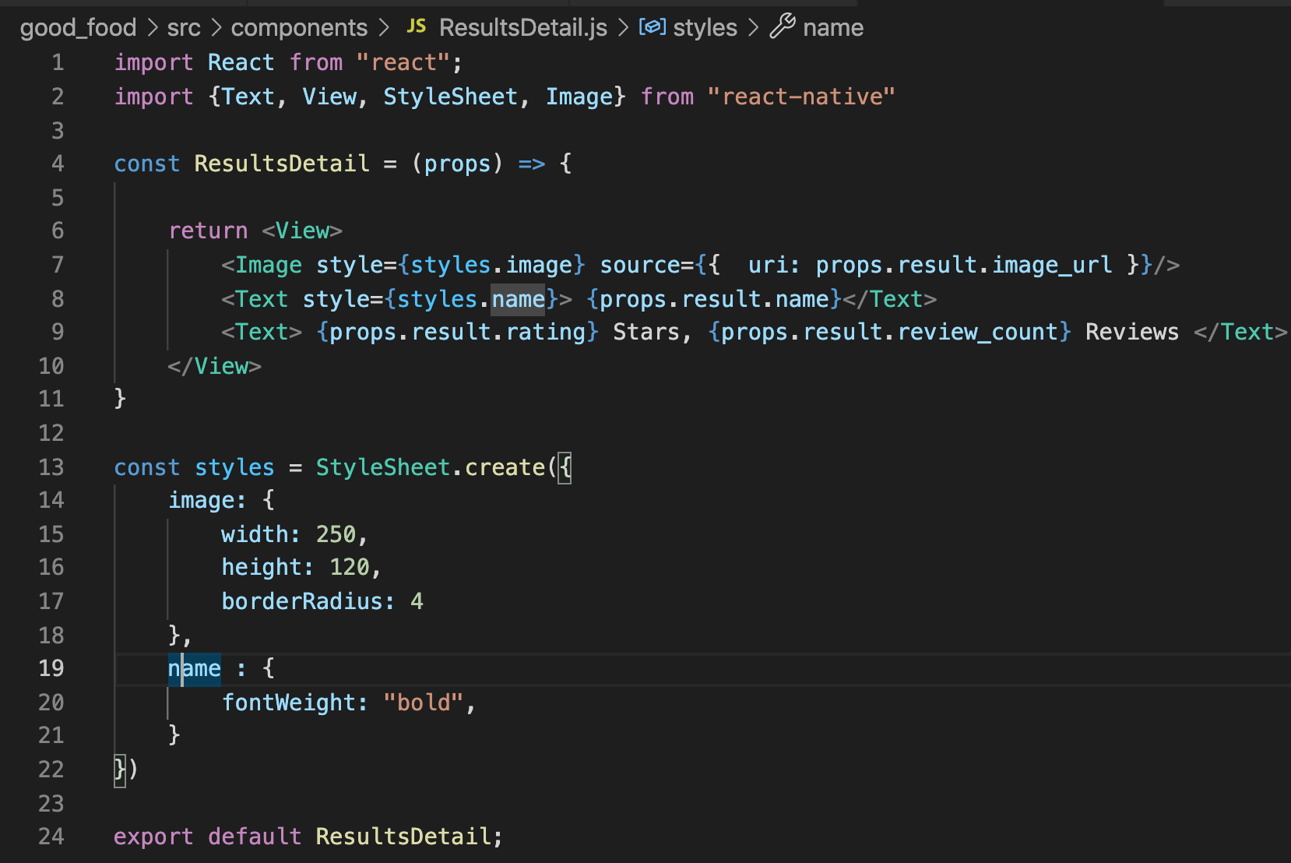

Displaying Our Lists of Results!
And we can make it even prettier!
Here, I added some styling for the restaurant name!
We also access more info from the results object, namely the rating and review count.

Slide 22

Displaying Our Lists of Results!
And we can make it even prettier!
Here, I added some styling for the restaurant name!
We also access more info from the results object, namely the rating and review count.

Slide 23
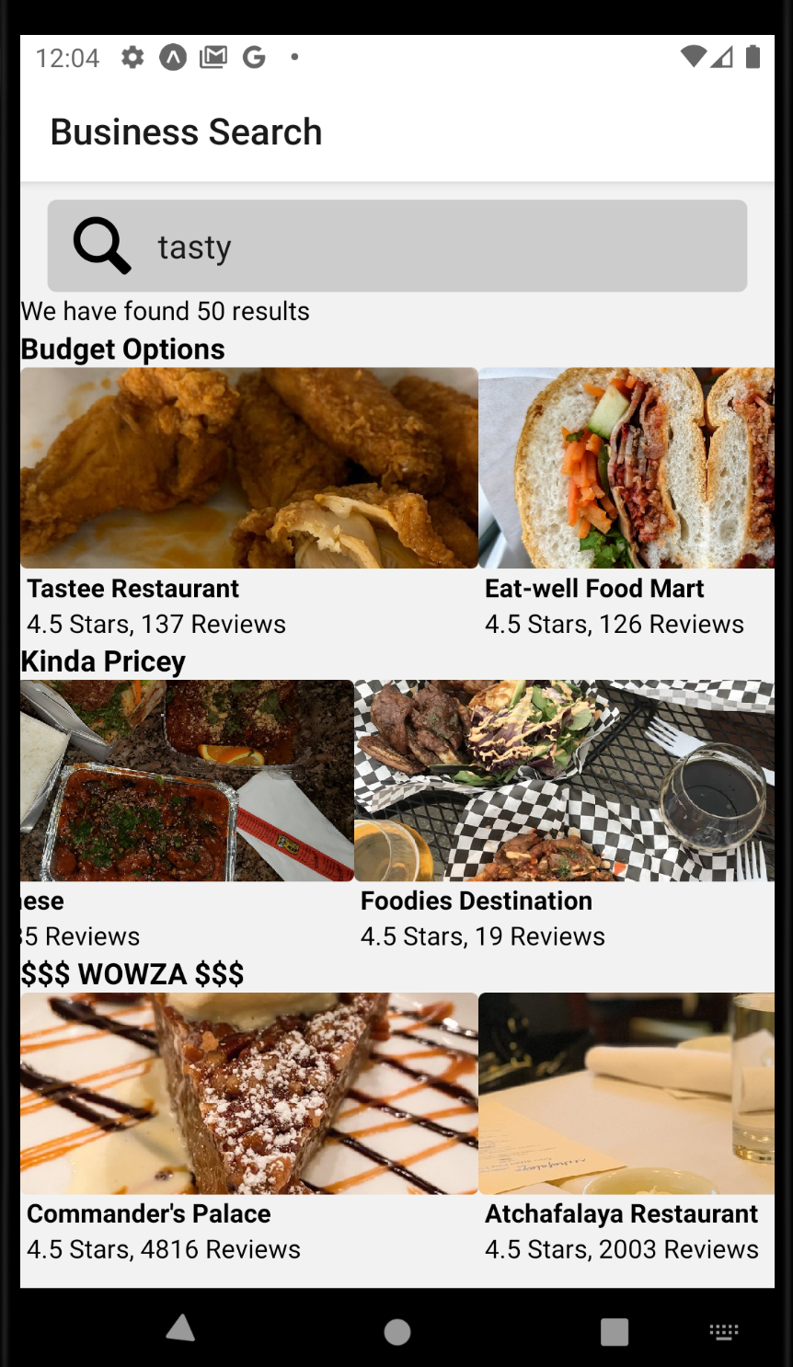
Displaying Our Lists of Results!
And the results aren’t too shabby!
And all of these lists are scrollable (you can see the middle list is “mid-scroll”

Slide 24
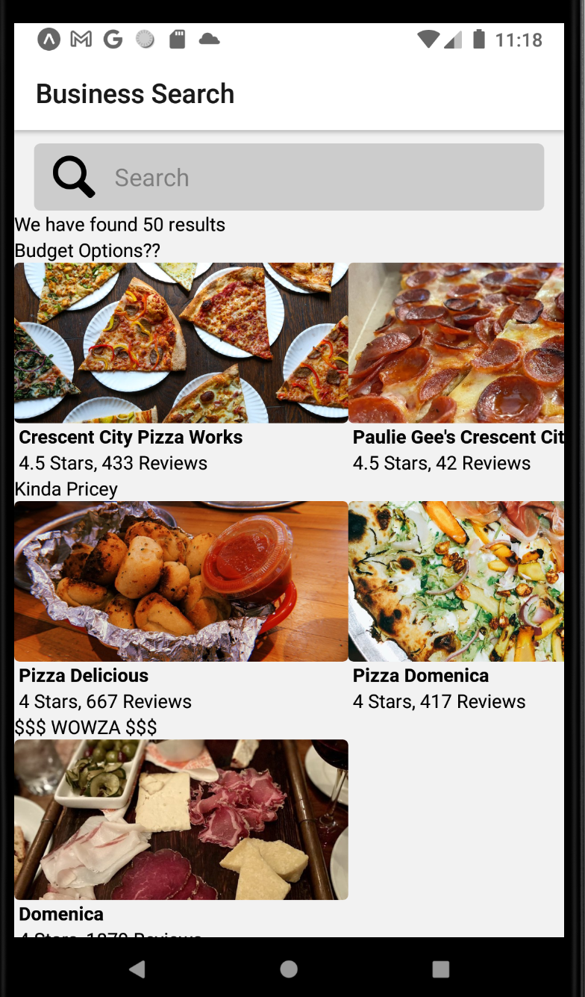


Displaying Our Lists of Results!
Depending on your phone, there’s a chance that some of the pictures may be pushed off the bottom of your screen.
And currently, there’s no way to scroll vertically!
We’ll get to that in just a second!

Slide 25
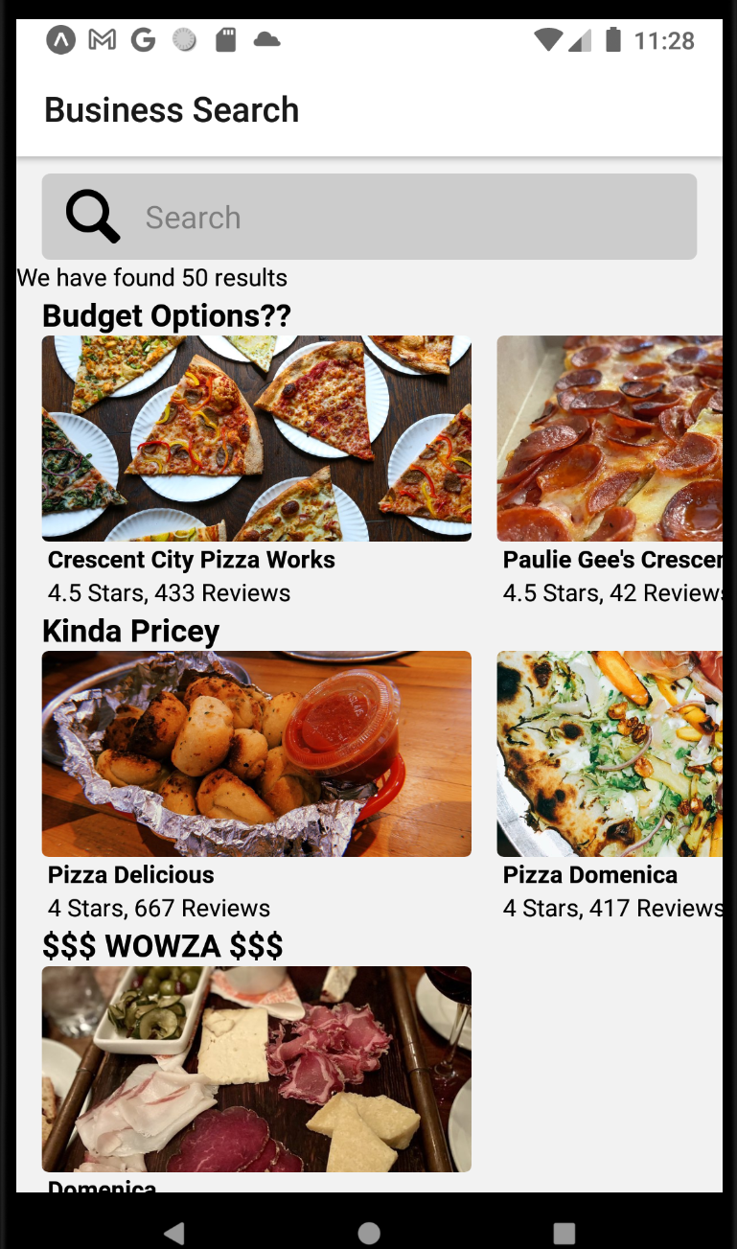
Displaying Our Lists of Results!
First, we can change the margins of our header text, our SearchBar component, and our ResultsDetail to all match, so it all lines up nicely!
I gave all of mine a marginLeft of 15.
Look at how nicely it lines up!

Slide 26
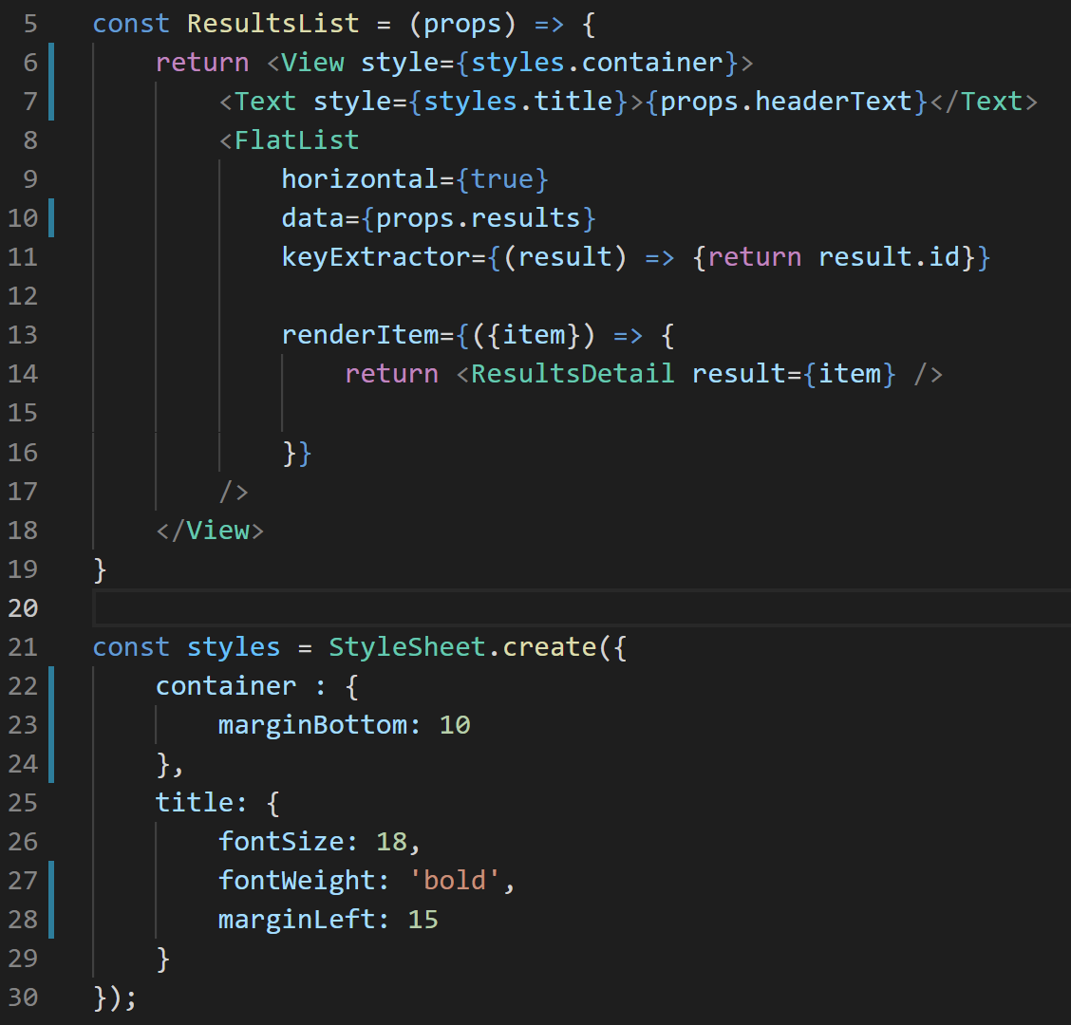
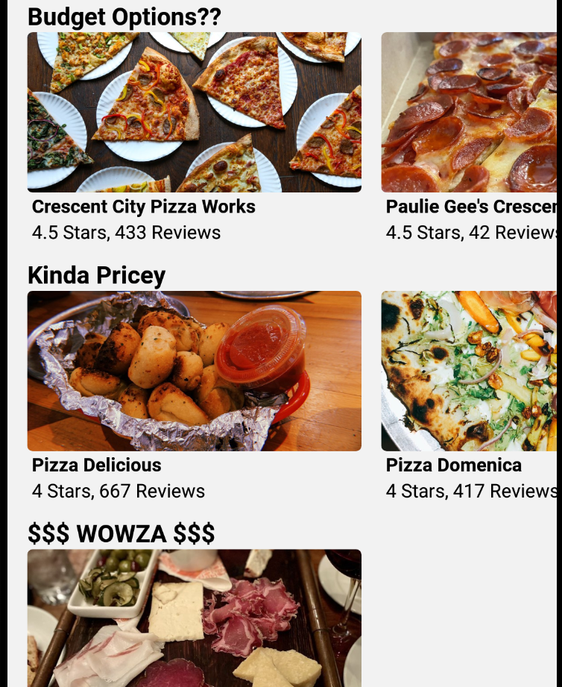
Displaying Our Lists of Results!
We can also add in some marginBottom on the container View of our ResultsList…

Slide 27
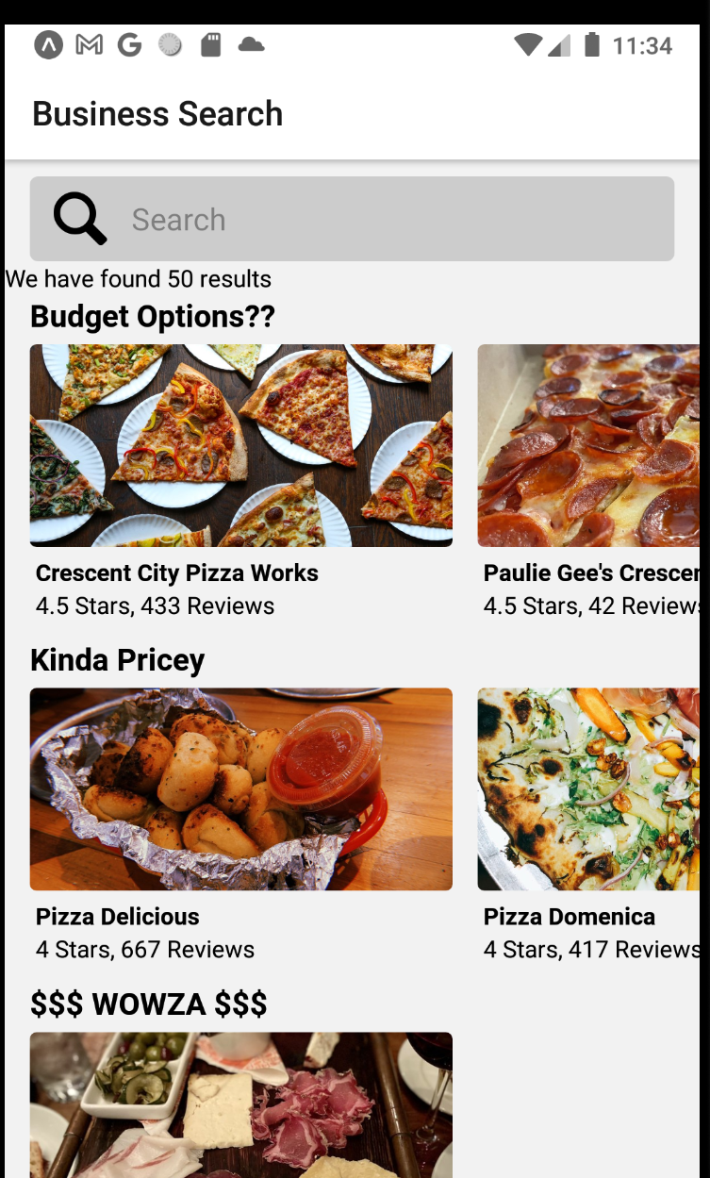
Displaying Our Lists of Results!
Likewise, we can add in some more marginBottom underneath our ResultsList headers…
And underneath our ResultsDetail images…
And little changes like that actually make a pretty big difference in how it looks!

Slide 28
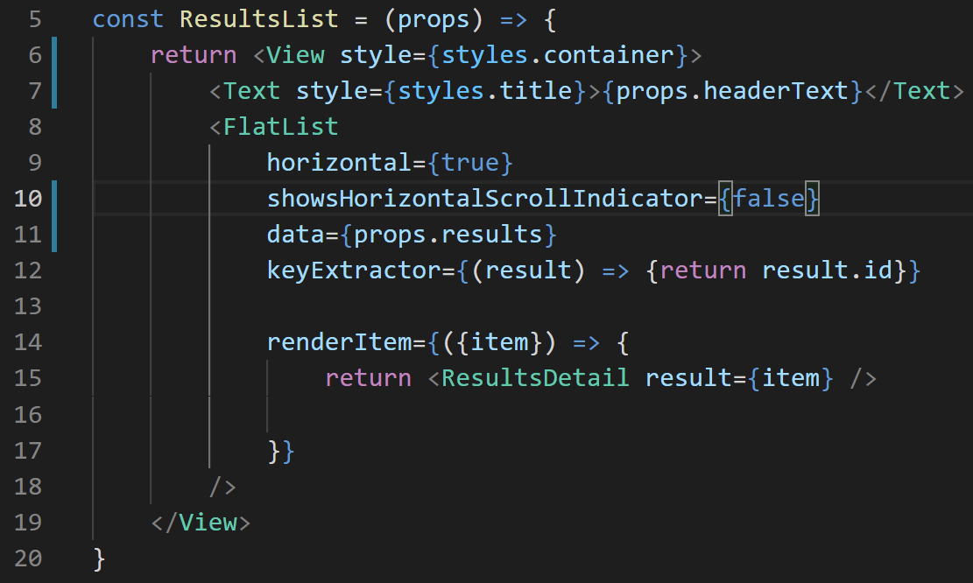
Displaying Our Lists of Results!
While we’re making these tiny quality of life changes…
Let’s also get rid of the horizontal scroll bar in our FlatList component!
By using the showsHorizontalScrollIndicator prop
The longest named prop?
We saw this once before, when we first learned about FlatList

Slide 29
Displaying Our Lists of Results!
But what about the bigger issue?
The fact that we can’t see the bottom of the screen?
Thankfully, there’s an easy solution!
Involving a brand new React Native primitive element: The ScrollView component.

Slide 30
Displaying Our Lists of Results!
SearchScreen.js
ScrollView is basically exactly the same as a View.
The difference is that if you have content that goes “beyond” the ScrollView, it will automatically enable scrolling!
we import it like all the other primitive components…

Slide 31
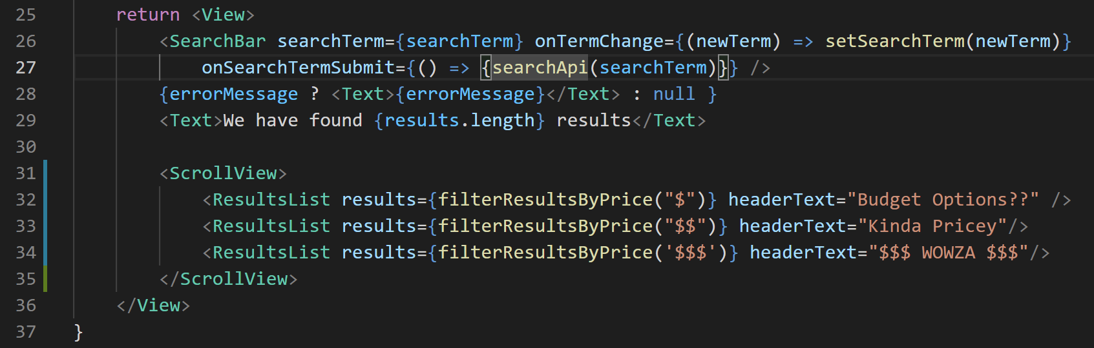
Displaying Our Lists of Results!
SearchScreen.js
And then we’ll just wrap our three ResultsList components inside of a ScrollView!
SearchScreen.js

Slide 32
Displaying Our Lists of Results!
However, if you were to try scrolling at this point, you would find that it scrolls A LITTLE, but not much.
Especially on Android devices, which is what I am working on.
(That is tough to convey via screeshot).
So we’re not quite done yet with that.

Slide 33
Displaying Our Lists of Results!
The issue is that our Views in general (and here specifically, our SearchScreen View), take up more space than we think they do!
Even if it goes all the way off the screen!
SearchScreen.js

Slide 34
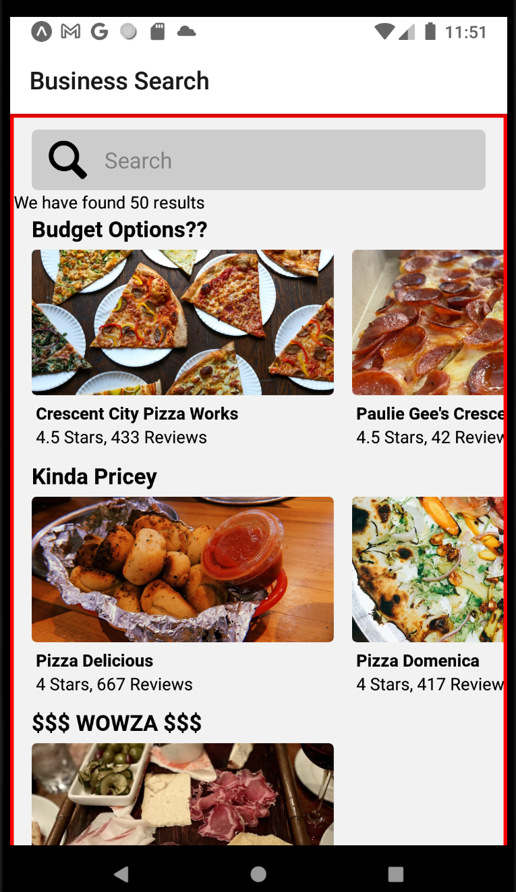
Displaying Our Lists of Results!
If we give our container View a border.
Say, of red color and borderWidth 3…
We’ll see this!
Note how the bottom border of our View is “off screen”
It’s there – we just can’t see it!

Slide 35
Displaying Our Lists of Results!
So again: the problem is that the View is expanding!
It is getting as big as it needs to be to fit all of the content.
Even if that makes it so big that it no longer fits on the screen!

Slide 36
Displaying Our Lists of Results!
BUT!
Even though this is a slightly new problem, it has a solution that we’ve actually discussed / seen before!
Does anyone remember…?
Remember how to get a component to fill up the remaining size of its parent?

Slide 37
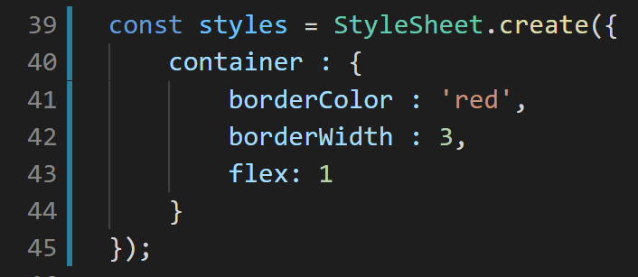
Displaying Our Lists of Results!
We did it by setting the flex property!
This basically said: “have me fill up the available space within my parent!
SearchScreen.js

Slide 38
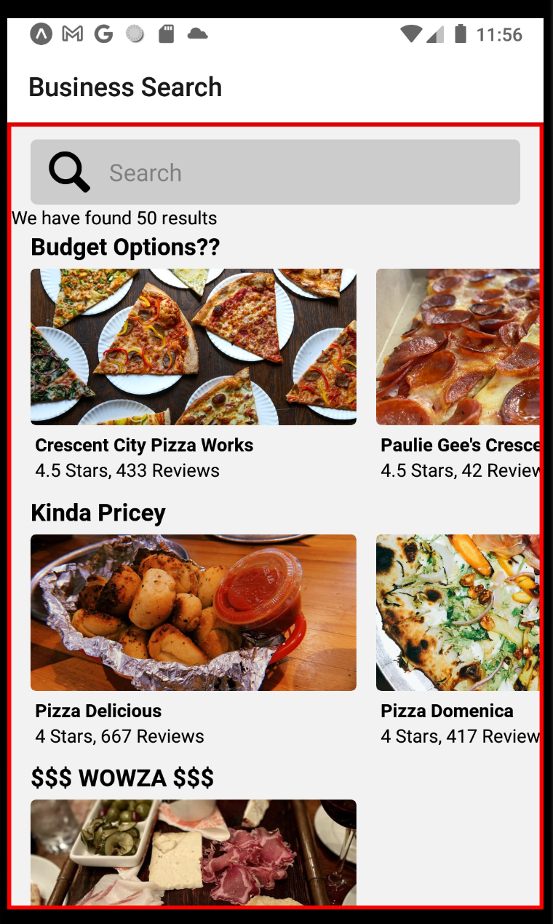
Displaying Our Lists of Results!
Which in this case, because the “parent” of this View is basically the entire phone screen itself…
It will make the View the size of the phone’s screen!
As evidenced by the border now being along the bottom as well.

Slide 39
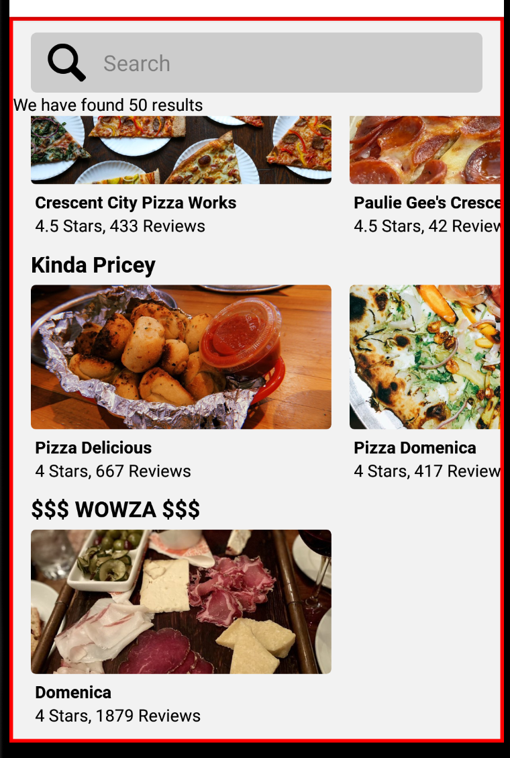
Displaying Our Lists of Results!
Now scrolling down works!
And note: “View” sizes can be very tricky sometimes!
Giving your Views (and other components) borders and backgroundColors can be VERY illuminating for layout debugging purposes!

Slide 40
Displaying Our Lists of Results!
On that same note…
If you have content that is getting cut off, or expanding off the screen…
Giving your most-parent View a “flex : 1” style can also be a very effective solution!

Slide 41
Displaying Our Lists of Results!
BUT WHAT IF I TOLD YOU… there was yet ANOTHER thing we could do…
This parent View component can sometimes be tricky, yeah?
Too much content? Expands off the screen?
Too little content? It gets super tiny and weird!
What if… what if we didn’t even USE that parent view element?

Slide 42
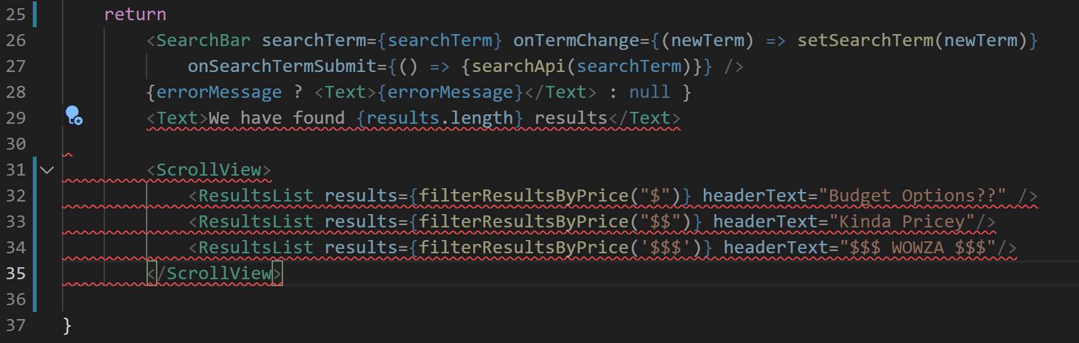

???
SearchScreen.js
“But Wait!” I hear you say!
We need to return exactly one top-level element!
That’s why we’ve been using View like that in the first place!
If we get rid of it, like we did above, we can see via the syntax highlighting that react native will be mad at us!

Slide 43
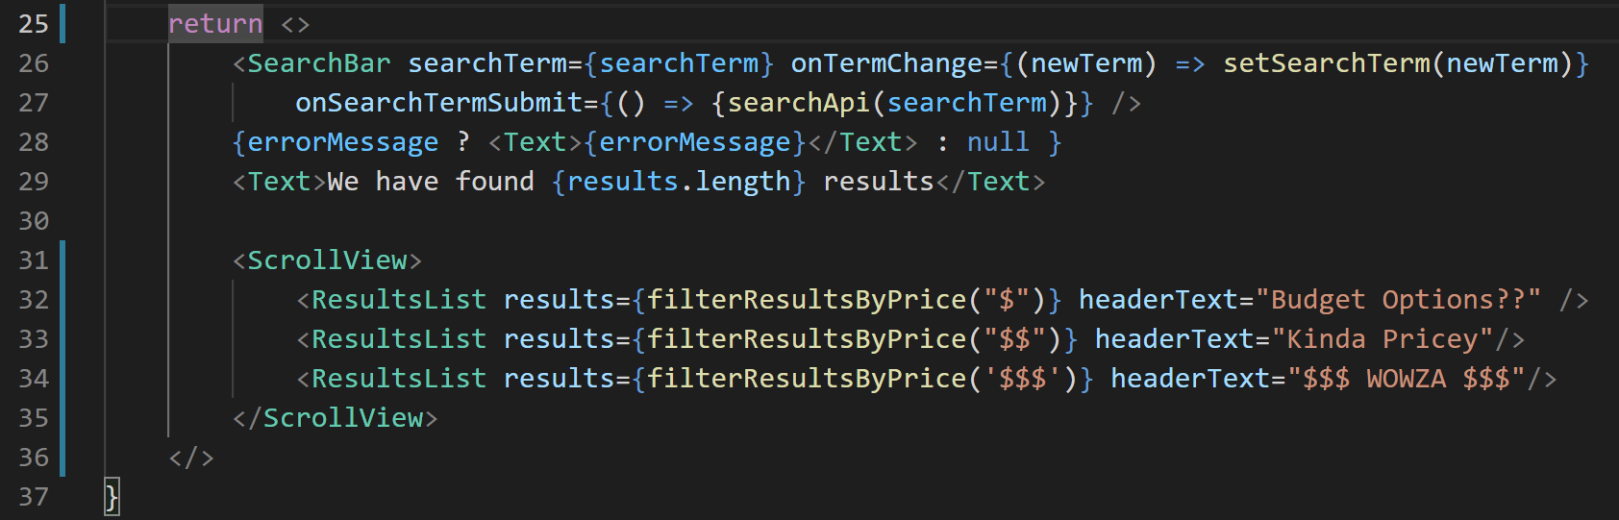
???
SearchScreen.js
WELL. it just so happens that there exists an alternative.
We can make use of the Empty Element!
That’s <> for the opening tag.
And </> for the closing tag.
It has the same effect of returning only “one thing”
But it tends to have fewer “content-sizing” related headaches!

Slide 44
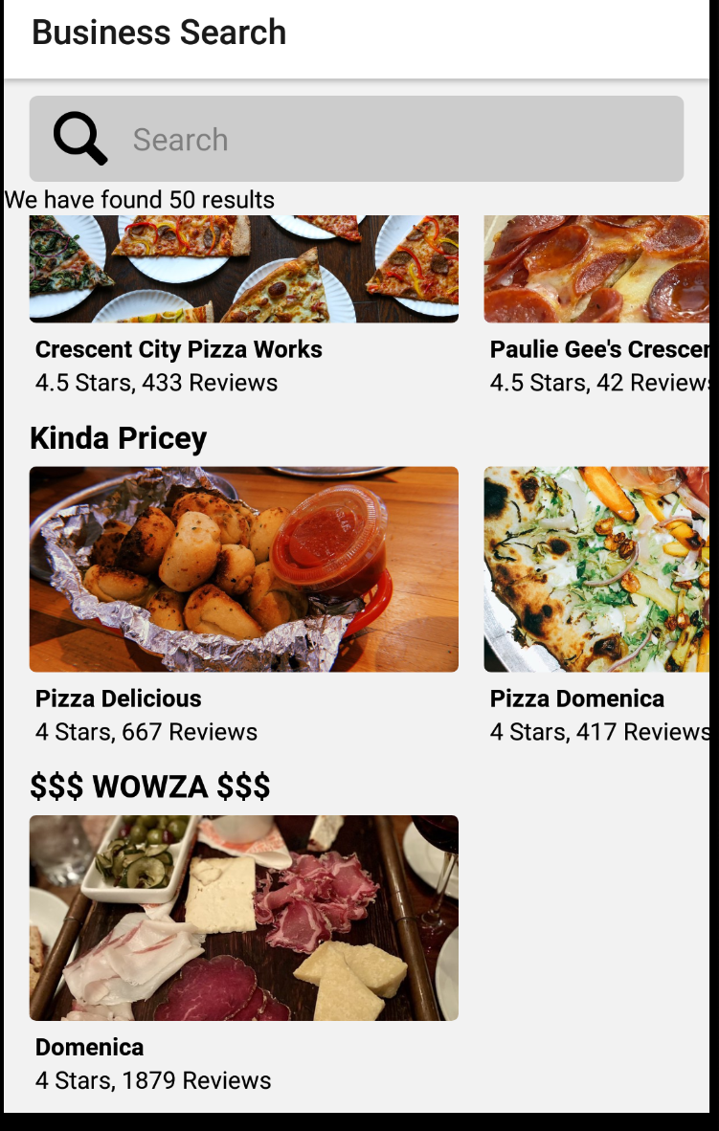

Displaying Our Lists of Results!
And it will still be perfectly scrollable.
One more quick change while we’re making quick changes!
Let’s get rid of that “we have found 50 results” text.

Slide 45
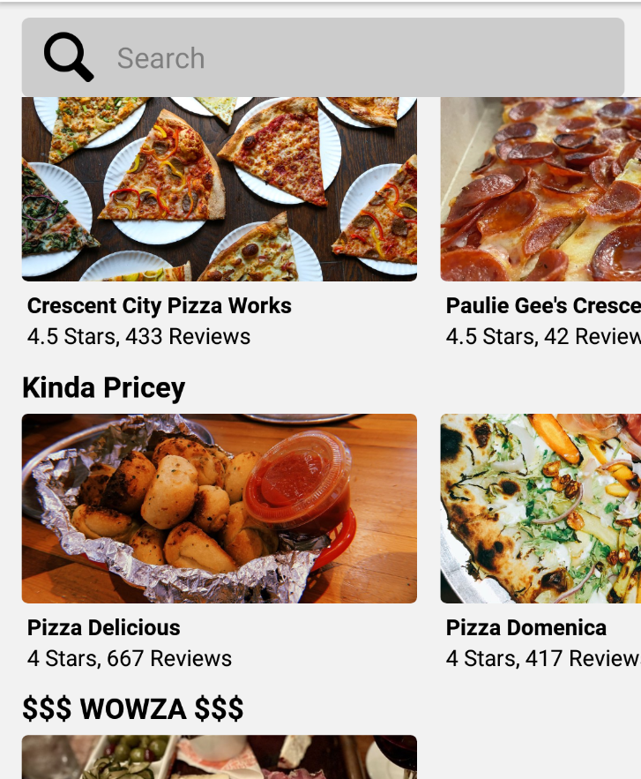
Displaying Our Lists of Results!
Removing that line is easy enough…
But it has an unexpected consequence!
That text was providing some white space that was making everything look nice!
Now, without it, our images jam right up against the search bar! And it looks kind of ugly.

Slide 46
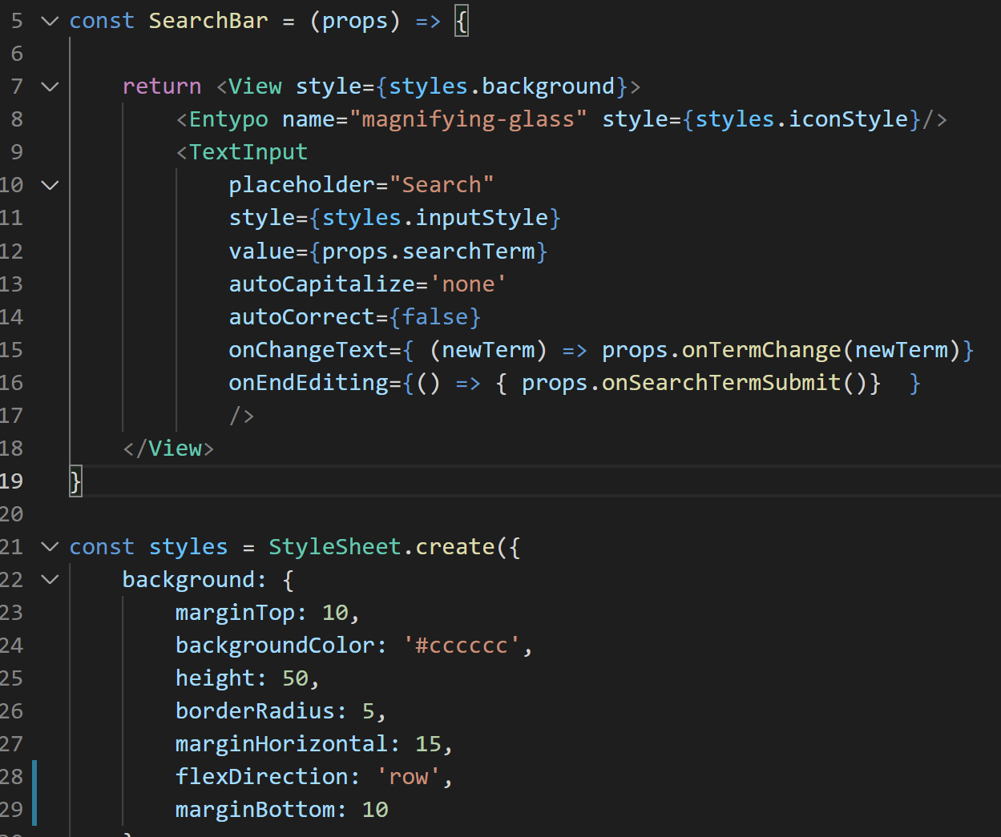
Displaying Our Lists of Results!
Which we can fix easily enough by adding more marginBottom.
I highlight this just to remind you that unintended consequences can happen!
So be vigilant as you change your apps!

Slide 47
Today’s Agenda
Displaying Our Lists of Results!
Displaying a Detail Page!

Slide 48
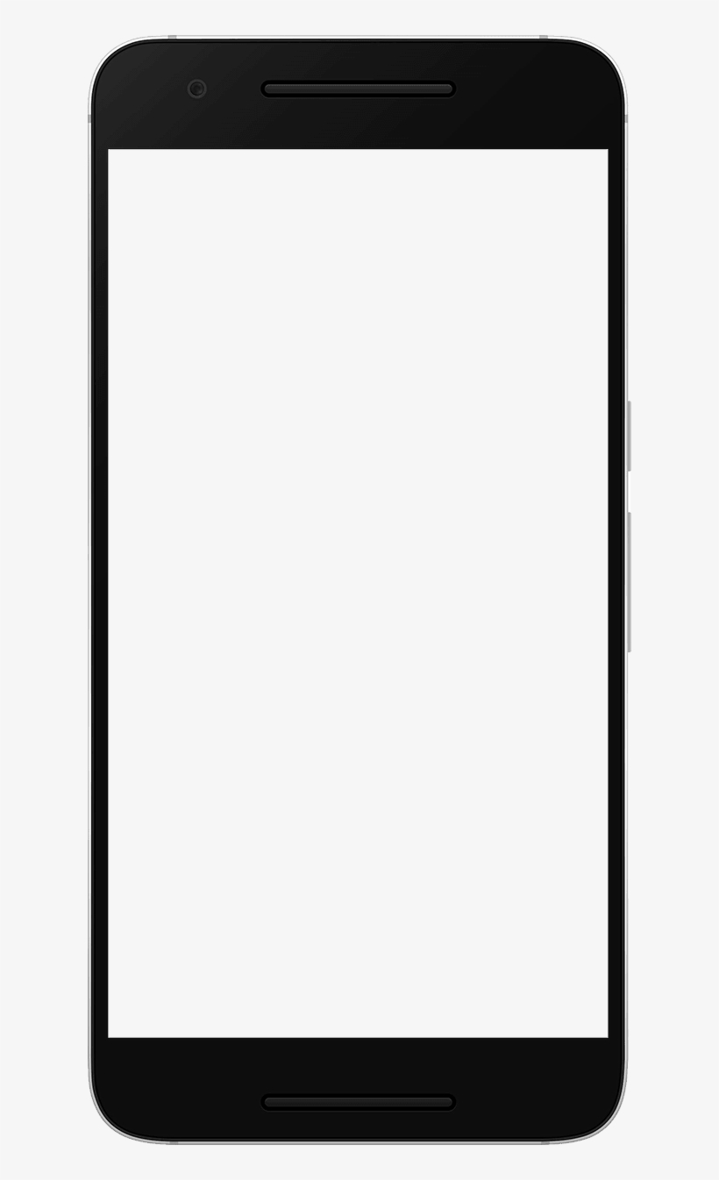
Displaying a Detail Page
Specific Restaurant
OK, we’re really on a roll!
That first screen is looking really good!
BUT remember, our goal was for there to be TWO screens!
$ Restaurants
Restaurant
Restaurant
Picture
$$ Restaurants
Picture
Restaurant
Restaurant
$$$ Restaurants
Picture
Restaurant
Restaurant

Slide 49
Displaying a Detail Page
SearchScreen.js
ResultsShowScreen.js
Specific Restaurant
The first screen is the SearchScreen.js that we’ve been working so hard on.
I’m going to call the other ResultsShowScreen.js
But clearly lots of other appropriate names as well.
$ Restaurants
Restaurant
Restaurant
Picture
$$ Restaurants
Picture
Restaurant
Restaurant
$$$ Restaurants
Picture
Restaurant
Restaurant

Slide 50
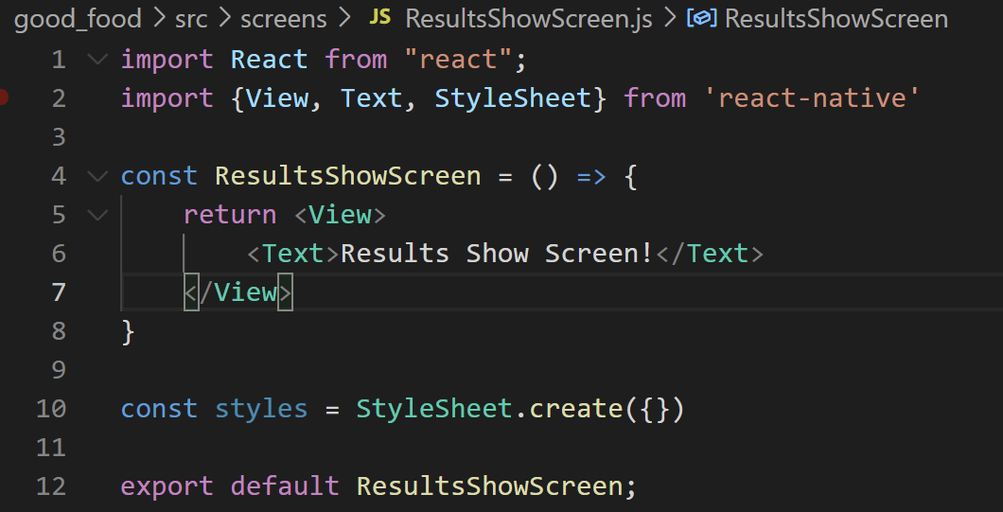
Displaying a Detail Page
This is going to be a new Screen, so in the screens directory of your source folder…
Make a new file called ResultsShowScreen.js
And start it off with the familiar boilerplate.
ResultsShowScreen.js

Slide 51
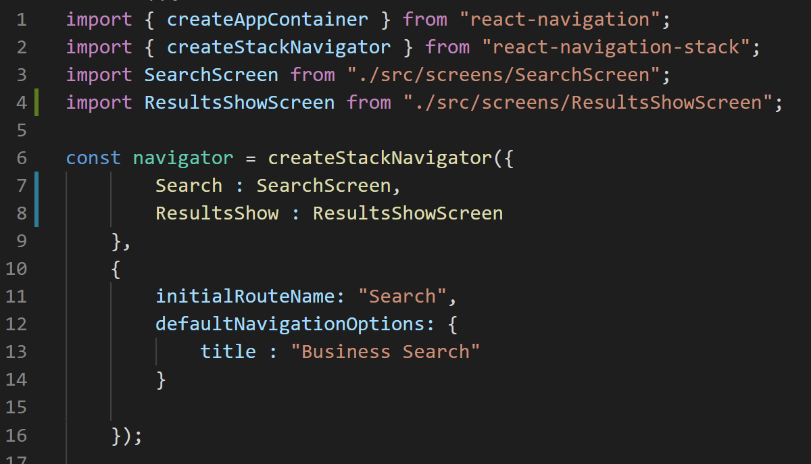
Displaying a Detail Page
And don’t forget!
When you have multiple screens, you need to write them up to your StackNavigator object, inside of App.js
That is, you import the component…
And you set up the route name.
App.js

Slide 52
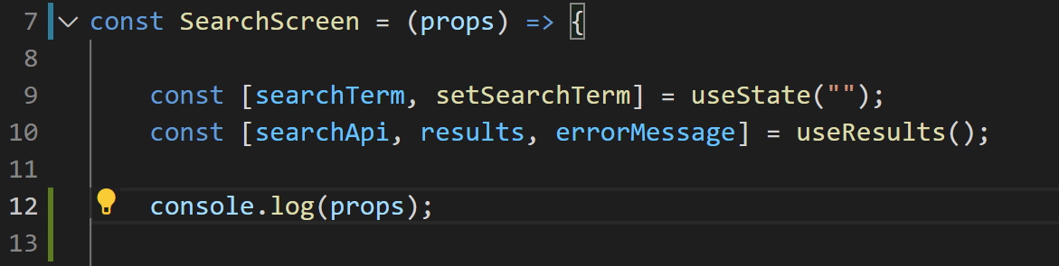
Displaying a Detail Page
Just to continue the refresher…
The StackNavigator ends up giving us a lot of information and functions (in the form of props)
We used this in the past to help us to navigate!
Note in SearchScreen, we’ve added the props parameter…
And are printing it out…
SearchScreen.js

Slide 53
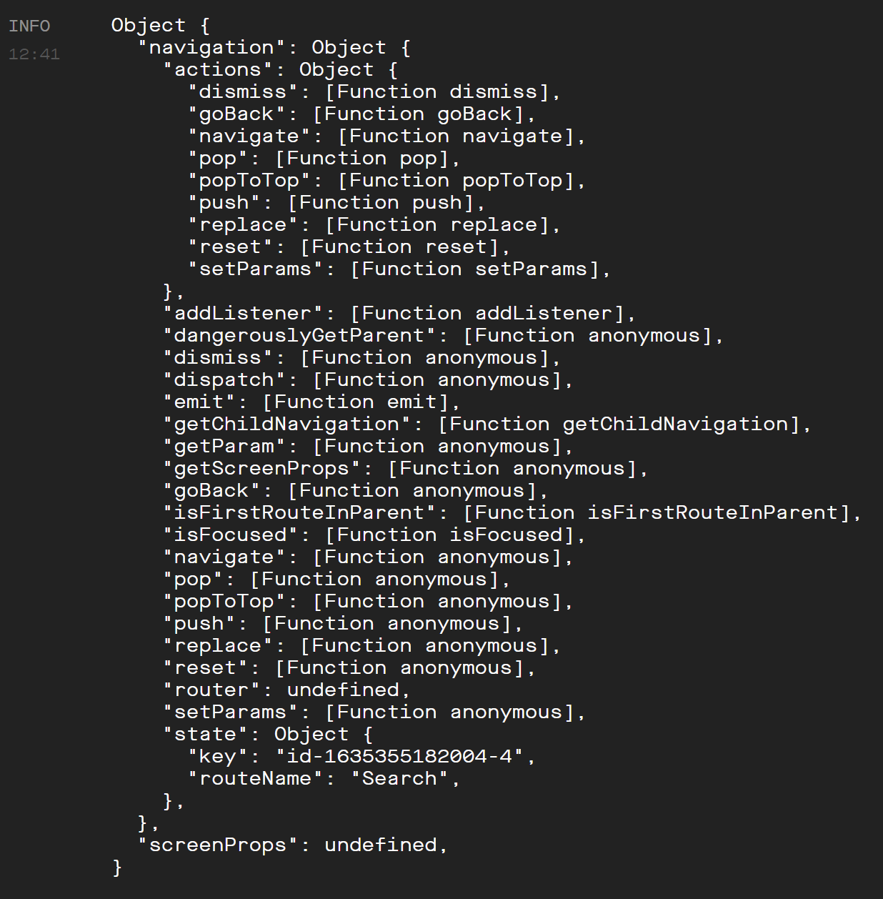

Displaying a Detail Page
And when we print it out, we get something that looks like this!
We’ve seen this before!
We’ve used this before!
We specifically used that navigate function to navigate from screen to screen!

Slide 54
Displaying a Detail Page
There’s a couple of things that are a little different this time around though…
The first is that, before, we invoked that navigate function as part of the onPress callback of a Button…
Specifically, a Button that lived in the top level component.
This time around, we want to invoke navigate when the user pushes on an image!
Well, we’ll have it be either the image, OR any of the text below an image too.
BUT, imagine if you will for a second – where does the image specifically live?

Slide 55
Displaying a Detail Page
But the images don’t live inside of the top level component!
i.e., they aren’t directly in SearchScreen.
Rather, SearchScreen has ResultsLists…
ResultsLists have a bunch of ResultsDetails…
And it is ResultsDetails that actually has the Image!
So we’re going to have to shepherd down this navigate function down to a child component.

Slide 56
Displaying a Detail Page
With regard to this shepherding:
As we’ve done a couple of times, I’m going to show you the “intuitive” way to do it
Which totally works!
And then we’ll see a possibly less intuitive, but arguably more effective, way of doing the same.
But starting with the intuitive way: how might you go about getting our child components in a place where they can leverage this navigation object?

Slide 57
Displaying a Detail Page
One thing to note is that the props that get passesd in via React Navigation is this big whole object.

Slide 58
Displaying a Detail Page
But we really only actually care about this, slightly smaller, navigation object.

Slide 59
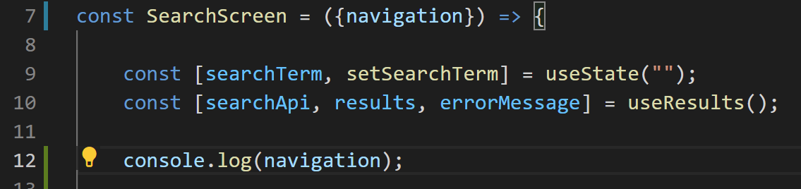


Displaying a Detail Page
So we can destructure that navigation object.
So now, instead of getting the entire props object like before…
We now are specifically JUST accessing the navigation object within that props object.

Slide 60
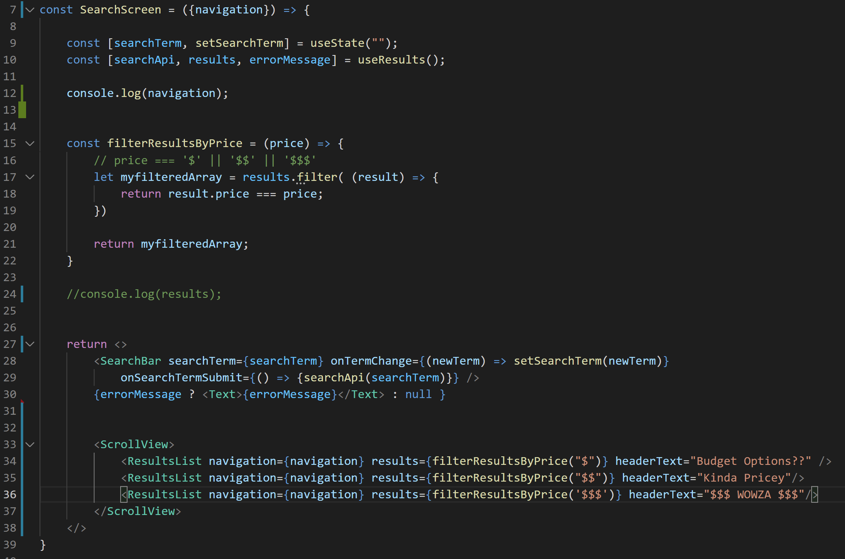
Displaying a Detail Page
And we can then pass this navigation object down to our ResultsList child objects via a prop…
Note that we do it for all three!

Slide 61
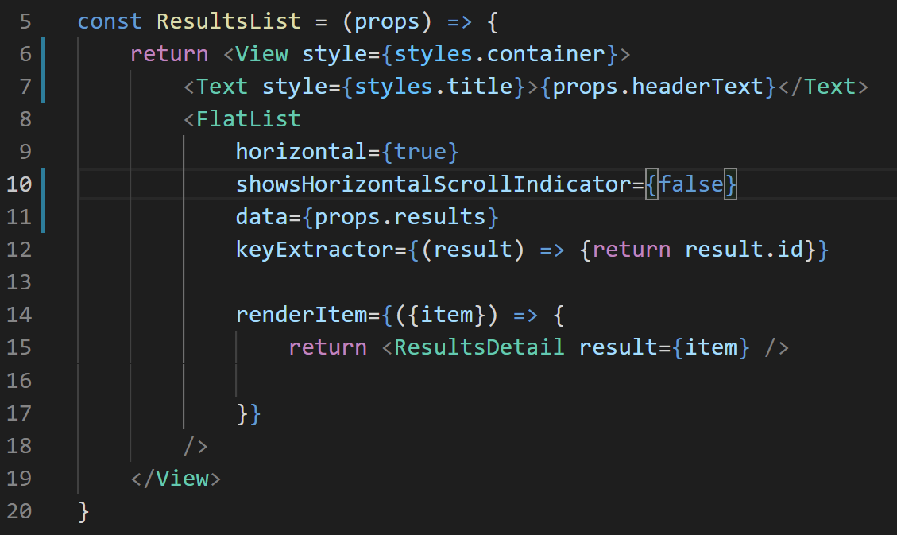
Displaying a Detail Page
And now inside of ResultsList, that props parameter should now have an additional property: the navigation object!
How would we use this to make it so that tapping on our ResultsDetail takes us to our detail screen?

Slide 62
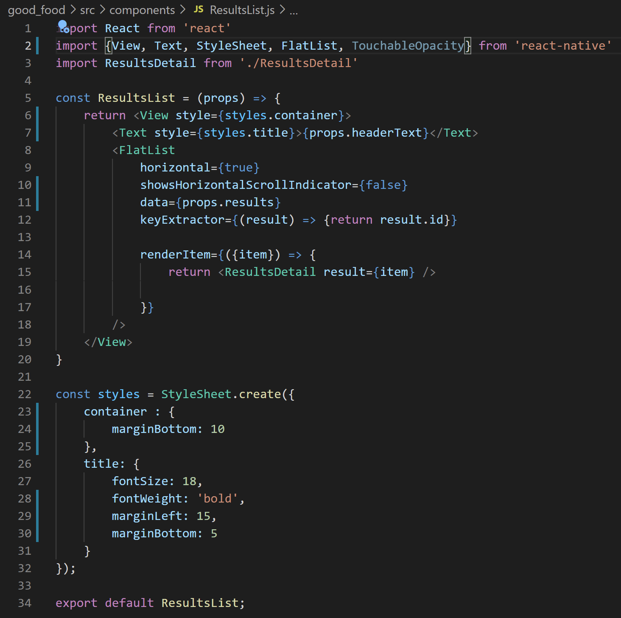
Displaying a Detail Page
WELLLL…
The first step is to import TouchableOpacity
Remember – this is the way to make other components “clickable”

Slide 63
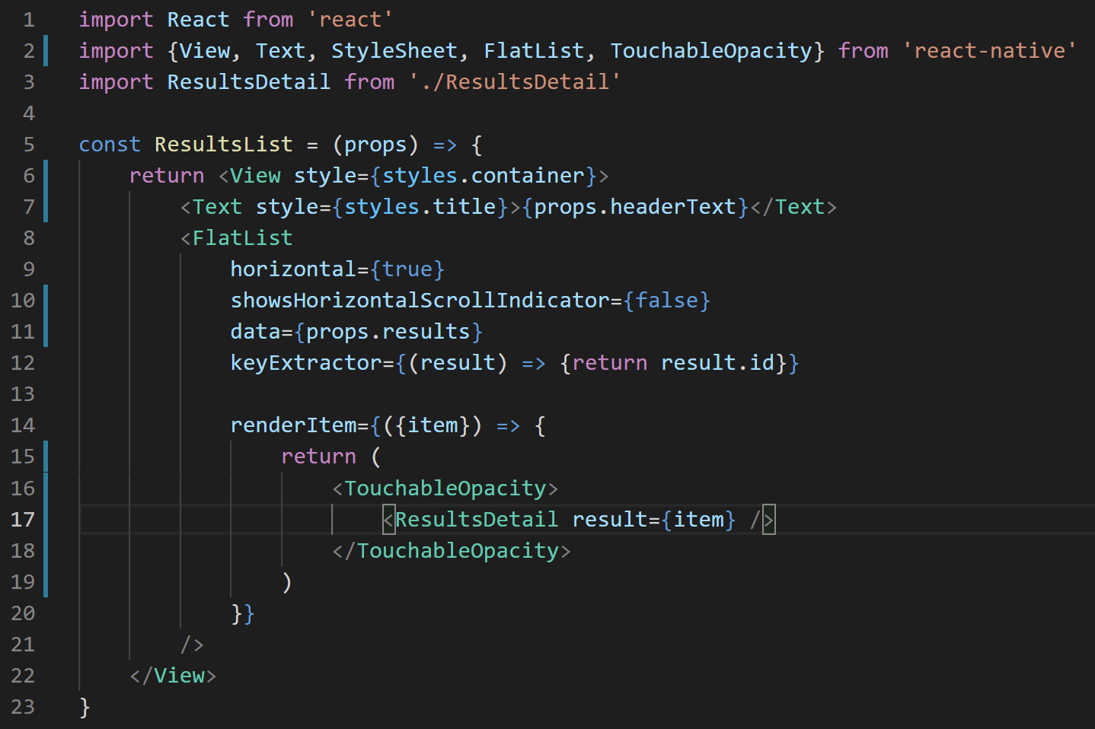

Displaying a Detail Page
And then we’ll want to use it!
We can wrap our ResultsDetail inside of this TouchableOpacity.
Note how I added ( and ) for the return statement – helpful to do if your first component isn’t on the same line as the return key word.

Slide 64
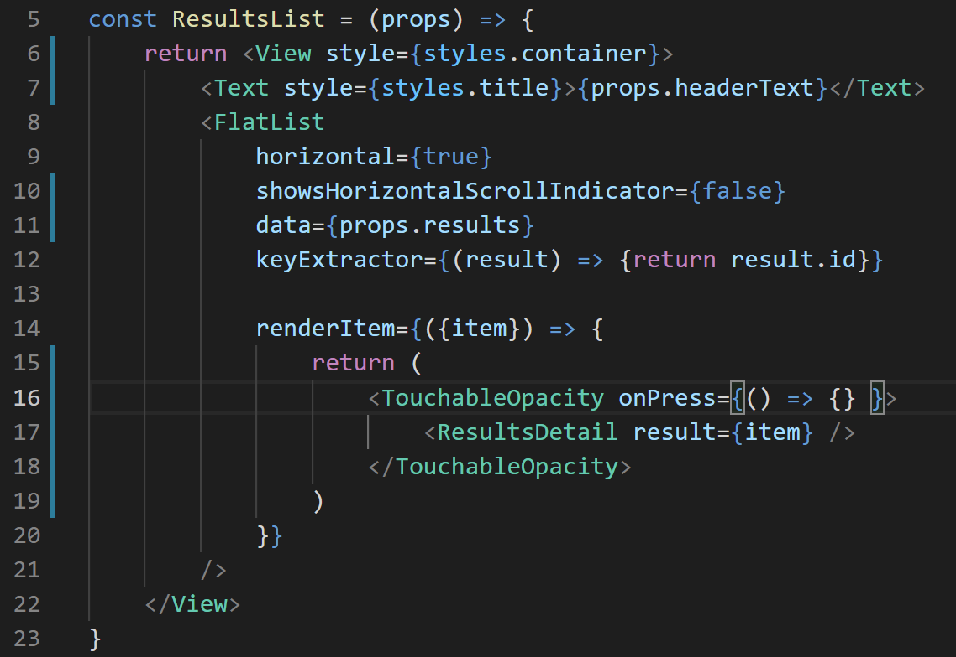
Displaying a Detail Page
And finally, as we all got lots of practice doing on the homework…
We give TouchableOpacity an onPress prop…
Where its value is a function that we want to invoke every time we press the ResultsDetail…

Slide 65
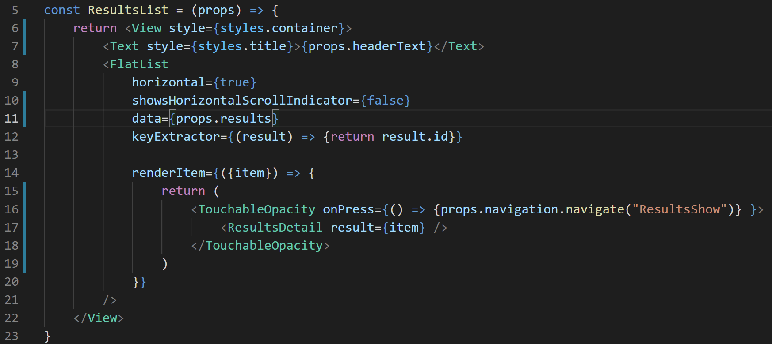
Displaying a Detail Page
Which might end up looking a little something like this!
Remember:
props receives all of the props from the parent component,
navigation is the name of the prop we care about; it’s an object
navigate is a function inside of the navigation object.

Slide 66
Displaying a Detail Page
And “ResultsShow” was the route name we specified back in App.js
And with this, we’ve achieved clickability!

Slide 67
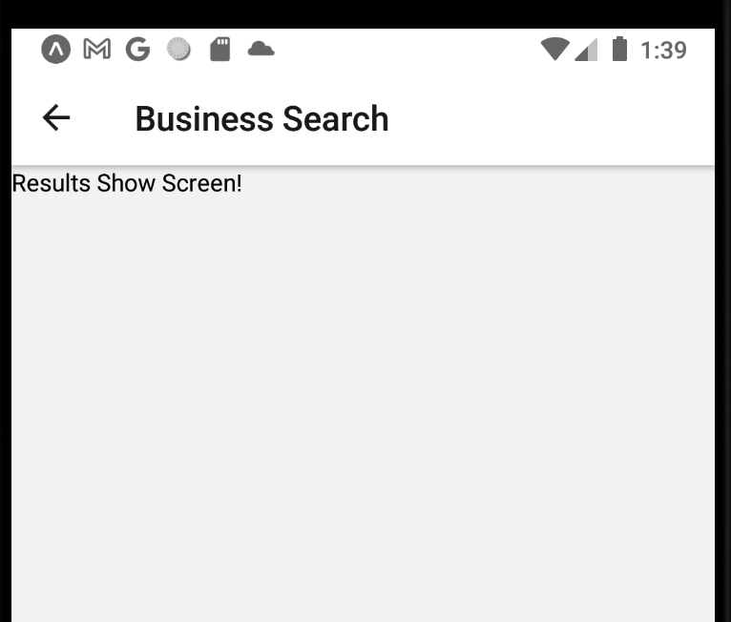
Displaying a Detail Page
And “ResultsShow” was the route name we specified back in App.js
And with this, we’ve achieved clickability!
Clicking on one of the businesses does, in fact, take us to a new screen!

Slide 68
Displaying a Detail Page
But there’s a couple of issues!
The first is obvious: it’s just the boilerplate text right now, and we want to gussy it up.
The second is “new” – we want to display specific, different details depending on WHICH restaurant got clicked on!
We haven’t actually seen or done this yet! We haven’t passed in our own custom props using react navigation before!

Slide 69
Displaying a Detail Page
But before we get to addressing those things…
Let’s revisit what I promised a moment ago.
Let’s shepherd our information differently.

Slide 70
Displaying a Detail Page
But before we get to addressing those things…
Let’s revisit what I promised a moment ago.
Let’s shepherd our information differently.

Slide 71

Displaying a Detail Page
Because right now, inside of SearchScreen, we ONLY make use of this navigation object for the sole purpose of passing it down to children.
Which, I dunno, feels kind of icky to me.

Slide 72
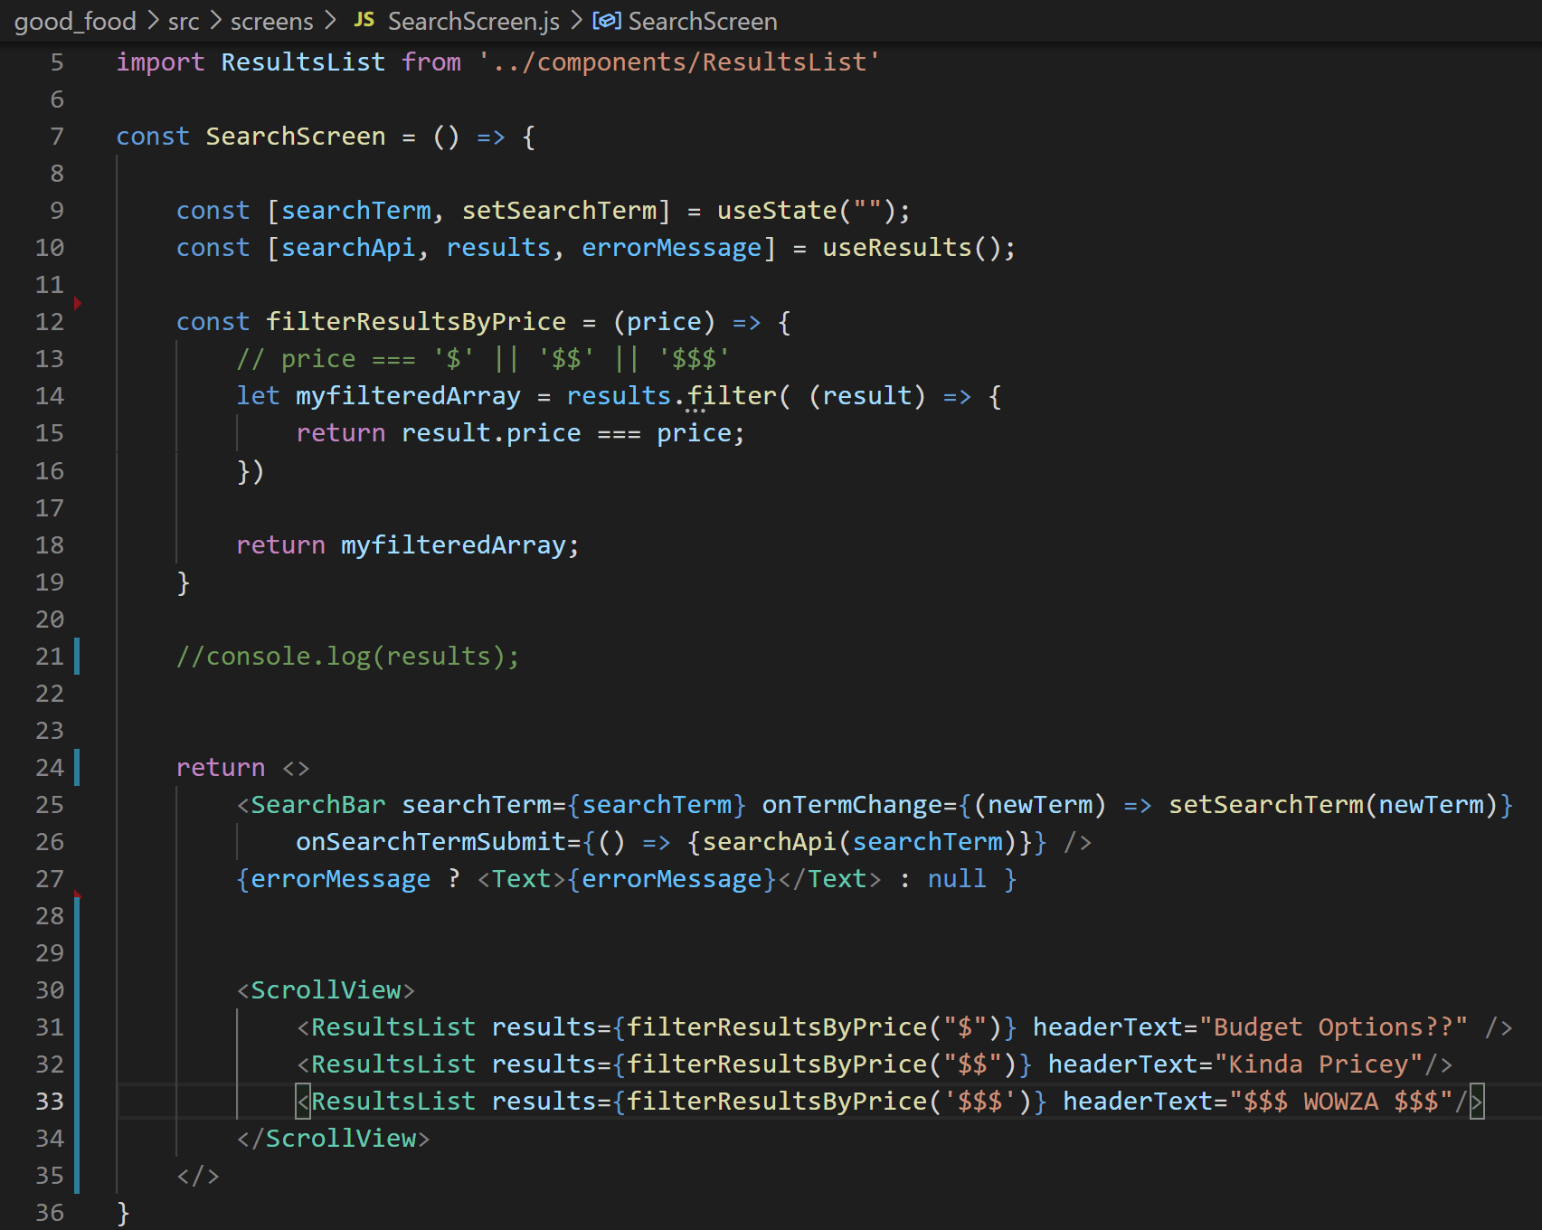
Displaying a Detail Page
Let’s get rid of all references to navigation here.
(I know, I know, we just worked hard to add all of them. But sometimes this is what refactoring looks like).

Slide 73
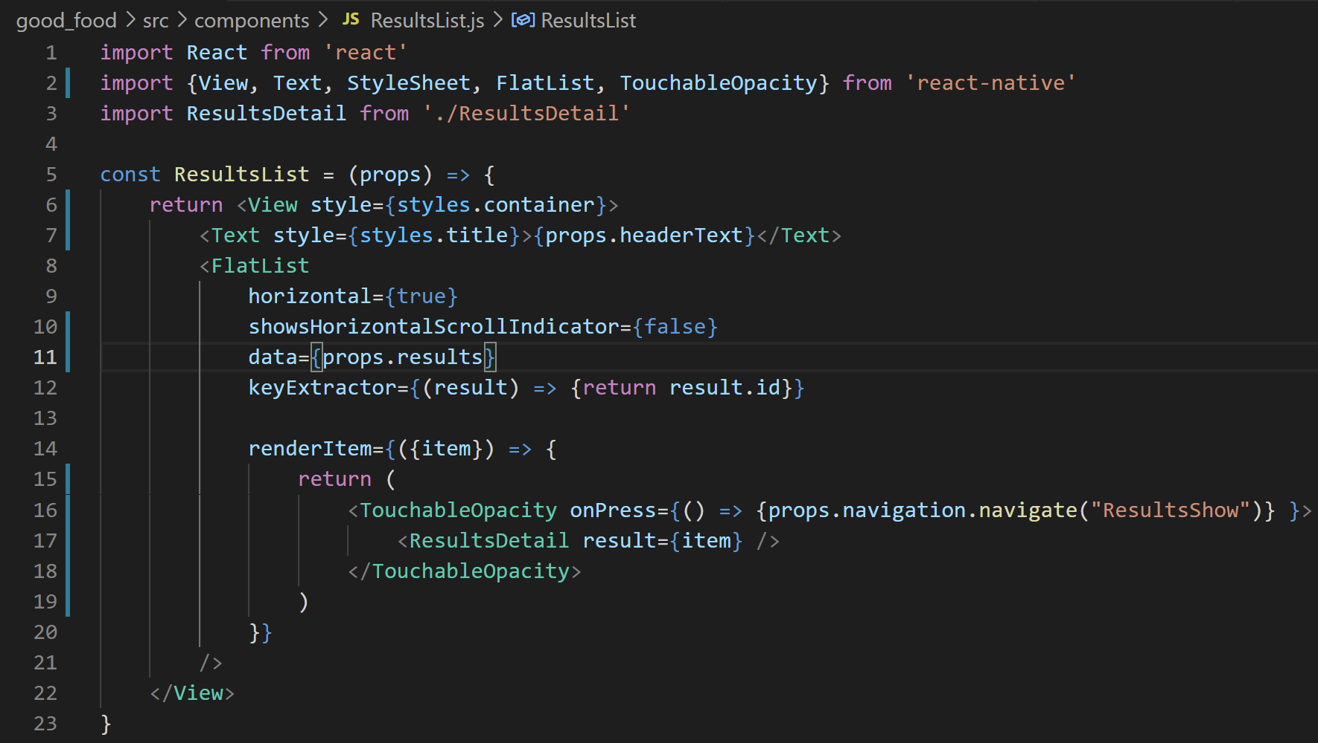
Displaying a Detail Page
ResultsList is the file that actually was USING the navigation object.
Of course, at this precise moment it can’t because it’s no longer receiving it from the parent.
How can we get it the navigation object?

Slide 74
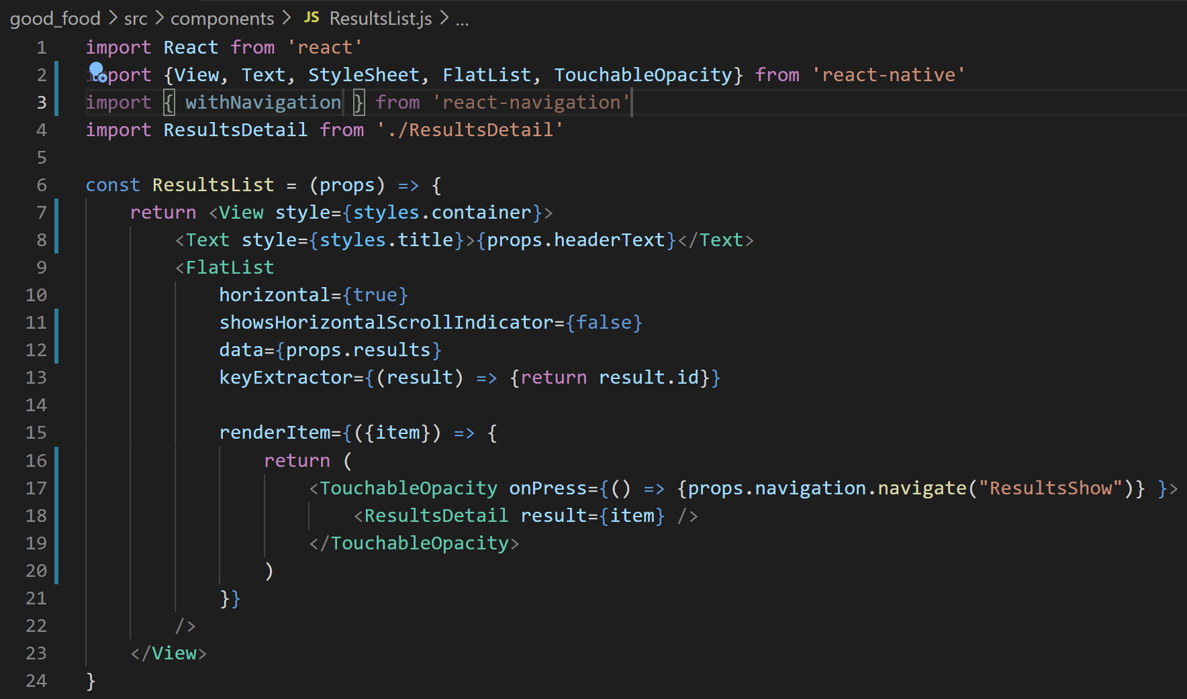
Displaying a Detail Page
Well… we’re going to have to import a new friend from the react-navigation library.
Specifically: the withNavigation function.

Slide 75
Displaying a Detail Page
withNavigation is a special function.
It will take as input a functional component…
And it returns… that same component… but… with navigation.

Slide 76

Displaying a Detail Page
So instead of simply exporting our functional component as we usually do…

Slide 77
Displaying a Detail Page
We will instead export our component… but withNavigation.
That is, we’ll return the version of our component that the withNavigation function produces.
This is going to have extra functionality that will give our ResultsList access to navigation.

Slide 78

Displaying a Detail Page
And now at this point you’ll see… it just works!
If you were to print out the props of the ResultsList…
You’ll see that it has both the props it received from the parent component (headerText and results)
But it ALSO has the navigation object, which we got for free through the use of this withNavigation function.

Slide 79

Displaying a Detail Page
So the functionality is the same, but now we aren’t ferrying that big navigation object through the SearchScreen.
Now, let’s focus on getting this screen to render those images!
In order to do that, we need to communicate to this screen WHICH business was clicked on.

Slide 80

Displaying a Detail Page
Thankfully, it is pretty straight forward!
As it turns out, you can pass some information along to the screen you navigate by using a second argument for the navigate function!

Slide 81

Displaying a Detail Page
That second argument is just an object that has the information you want to pass along!
So maybe something like this!
We have the second argument, it is an object.
It has one property, id.
Whose value is the id of item.
We recall, item in this context IS a business.

Slide 82
Displaying a Detail Page
So OK great! We’re now “sending” that information to the ResultsShow screen!

Slide 83

Displaying a Detail Page
But now the question is…
How do we access that information from inside of ResultsShowScreen?

Slide 84


Displaying a Detail Page
Well.. if you guessed it would involve using props, you’d be right!
But it is going to be slightly more complicated than what we’ve done before.

Slide 85

Displaying a Detail Page
Well.. if you guessed it would involve using props, you’d be right!
But it is going to be slightly more complicated than what we’ve done before.
If we were to print out the props, you’d see that it would be the same object that has a navigation object, as we’ve seen before.

Slide 86

Displaying a Detail Page
What we’ll specifically need to make use of, is the getParam function.
This is a function where we pass in the “key” that matches one of the properties of the object we passed in when we called navigation.navigate()…
And it will return its corresponding value.

Slide 87

Displaying a Detail Page
So here we are, ack in ResultsShowScreen.js
Note how we use props.navigation.getParam(‘id’);

Slide 88
Displaying a Detail Page
The id comes from the fact that the object we passed into our call to navigate had a property called ‘id’
And what getParam() will return will be its value!
i..e, in this case, the id of the restaurant we clicked on!

Slide 89

Displaying a Detail Page
And indeed, when we print out the id…
It prints out a random gobbledygook of characters!
Which you and I know to be the special YelpID of the restaurant in question!

Slide 90
Displaying a Detail Page
And now that we have this, this humble string, we’re really in business!
Our goal is to populate this screen with images from the restaurant we clicked on!
So I throw it to you – based on what we know, how can we do that? How to turn this id into a bunch of beautiful images?

Slide 91

Displaying a Detail Page
Well, the images come from the Yelp API!
And if you recall, THIS endpoint in particular lets us specify an id…

Slide 92


Displaying a Detail Page
And produces a response that has urls to a bunch of photos!
And we can see that the photos are specifically in an array…
As one property of a single big object with lots of information about the specific business we are asking about!

Slide 93

Displaying a Detail Page
So let’s get crackin’!
Here, we have our ResultsShowScreen.js file…
And we are importing our Axios instance.
Remember: this is what will help us make API calls to yelp!

Slide 94

Displaying a Detail Page
And we’ll add a little helper function!
We’ll make the API request inside of it.
We’ll have it take as a parameter the id of the business that we are looking up.
Do you remember how to make an API call?

Slide 95

Displaying a Detail Page
The function call is “easy” – it’s just called get, since we are making a “get request”
And we’ll pass in a string, specifying the endpoint we want.
Note our use of String templating!
We use back ticks, ` and `, to combine String literals and variable values together without concatenation.

Slide 96
Displaying a Detail Page
And we also use the await keyword!
Remember, this was a way to say “hey – don’t do the rest of this function until the following statement finishes”
Because yelp.get() involves a network request, and can therefore potentially take some time.

Slide 97

Displaying a Detail Page
And if you want to use await, you need to make sure that you mark the function you use it in as asynchronous, using the async keyword.

Slide 98

Displaying a Detail Page
This whole thing is going to get us an object, which we can store in a variable for our future use.
OK, this is great! But what do we ultimately want to do with this response…
WELL… we want to draw some images on the screen based on it, yes…?

Slide 99

Displaying a Detail Page
Which is basically a giveaway that we’re going to need to make use of the react native state system.
We’ve seen this lots before, so we’re going fast here!

Slide 100

Displaying a Detail Page
One thing that we haven’t done too many times before: we’ll make the default value of result here null.
Eventually we want this to be an object full of business data.
‘null’ will be our way of knowing that it doesn’t have any data yet.

Slide 101
Displaying a Detail Page
So before we display our data, well just have to make sure that result isn’t null.
Because if it is, it means our request hasn’t finished going through yet!

Slide 102

Displaying a Detail Page
Anyway, now that we have state set up…
We can pass in the response to it once we get it from Yelp!
(Technically the part of the response we care about is in the data property).

Slide 103
Displaying a Detail Page
So, OK! We’ve got this lovely helper “getResult” function now.
But we’re not calling it anywhere!
Riddle me this: how do you think we should go about calling it?

Slide 104
Displaying a Detail Page
We probably want it to run once, and only once, when the screen is first rendered…
Is that ringing any bells…?

Slide 105

Displaying a Detail Page
It’s our old friend, useEffect!
We import the hook!
And we use it!
Remember: for the “make some code run exactly once” functionality we want, we need to give it two arguments:
The first: a function whose body is the code we want to execute exactly once.
The second: an empty array.

Slide 106
Displaying a Detail Page
And the code that is executing once on start up in this case is our call to getResults().
This way, we get the results exactly once when the screen loads up!
And we avoid that infinite loop issue we saw before!

Slide 107

Displaying a Detail Page
We can verify that everything is hooked up ok with a console.log line.
Now, if I click on, say “Pizza Delicious” in my app…

Slide 108

Displaying a Detail Page
The log would be the following!
When the screen first renders, it displays ‘null’ because we haven’t gotten the results yet.
But thanks to useEffect, we invoke the function to get the data from Yelp,
Which we then store inside of our state variable…
Which causes the screen to rerender
Which then makes it so that when we console.log the result, we see what we see to the right!
Tons of fantastic information about Pizza Delicious!

Slide 109

Displaying a Detail Page
Now that we have the data, now it’s just a simple matter of actually displaying it!
Not a problem!
The one thing to remember though: we don’t always HAVE the data. At first its null!
So let’s be vigilant about that.

Slide 110
Displaying a Detail Page
We can test that with !result
If result is null, then !result will evaluate to true.
In other words: this block right here is stuff that we’ll do if we don’t have a result yet.

Slide 111

Displaying a Detail Page
And to keep things easy, we’ll just return null!
That is, if we don’t have the data yet, we won’t display anything!
We could make this fancier with error messages and stuff later on.

Slide 112


Displaying a Detail Page
So now, if we get PAST that return statement, it must mean that we have the data, and we can use it freely. We can use it in our JSX..
And see it display in app!

Slide 113

Displaying a Detail Page
Of course, we don’t just want the name… we also want to display all the photos!!!
In a List…
Perhaps in a… FlatList if you will…

Slide 114
Displaying a Detail Page
Before making the FlatList, remember what it is that we want / have.
we want a list of photos.
The photos live in an array in our response object, called “photos”
Each element of that array is a String.
Specifically, a string that is the URL to that photos location.

Slide 115

Displaying a Detail Page
That might have props that look like this!
data are the photos from our result!
keyExtractor is simply going to return the url of each photo.
and renderItem will use that uri technique to fetch the photo from the provided url.

Slide 116

Displaying a Detail Page
And remember, images like to be flat for whatever reason.
So you can style your images with some height and width.
ALSO, if you haven’t yet, make sure you import the Image component.

Slide 117

Displaying a Detail Page
And that’s…. kinda it!!!!
We can load up our app, and it will show us all of these mouthwateringly wonderful restaurants.
And if we click on… say… Pizza Delicious…

Slide 118

Displaying a Detail Page
It takes us to a screen that has photos specific to pizza delicious!
INCREDIBLE!

Slide 119
Displaying a Detail Page
Now, clearly there’s lots of ways we can improve this app… but we’ve been working on it for a while now.
It’s time to move on!
Let’s just make a couple of quick fixes…

Slide 120


Displaying a Detail Page
One is that, when you make a search, sometimes the header text of the categories is there before the images themselves. (I wasn’t fast enough to get a screenshot of this).
The other, is that sometimes its weird if there are no restaurants of a certain category.
e.g., there are no $$$ fast food options.

Slide 121


Displaying a Detail Page
We can address both of these with a super quick fix!
Inside of ResultsList, we’ll add the following check…

Slide 122

Displaying a Detail Page
If the results array has no length…
i.e., If there are no results…
Then don’t display any aspect of the list.
Otherwise display the list like normal.

Slide 123

Displaying a Detail Page
And indeed, the third category of food is now entirely absent, if there aren’t any options there.

Slide 124
Displaying a Detail Page
OK! My goodness. That was many lectures for that app! BUT! We learned so much!

Slide 125
Displaying a Detail Page
We learned how to work with data from APIs!

Slide 126
Displaying a Detail Page
We learned how to pass data from screen to screen, with the getParam() function!
And how to give all screens access to navigation with the withNavigation() function!

Slide 127
Displaying a Detail Page
We learned how to have things happen exactly *once* on start up, with the useEffect hook!

Slide 128
Displaying a Detail Page
We learned how to create our OWN hooks!
And in so doing, got a deeper glimpse into how the other hooks we have been using work behind the scenes!

Slide 129
Displaying a Detail Page
We learned how to create brand new projects from scratch! We are no longer bound to rn-starter!

Slide 130

Displaying a Detail Page
We learned about the existence of the vector icon library, and all sorts of great iconography you can add to your apps!

Slide 131
Displaying a Detail Page
Plus, we also just got a lot of extra practice with…
TextInput stuff
Layout stuff
FlatList stuff
State system stuff
JavaScript stuff
And lots more besides!

Slide 132
Displaying a Detail Page
BUT – for as much as that app taught us – there’s still a lot more to learn!
Stay tuned, as we embark on a brand new application… next time!

